Slide 1

Pharmaceutical Distribution Network
Mohammed Anzal Zafar Shaikh - 002815597
Mohammed Zakir Memon - 002275641
Sanal Pillai - 002878588

Slide 2

Introduction
The Pharmaceutical Distribution Network project is about managing how drugs are made, sent out, and given to people. It uses technology and good planning to make sure drugs are made right, moved safely, and get to where they need to be when they need to be there, all while following the rules.

Slide 3

Problem Statement
The process of getting, moving, storing, and delivering medicines is what the medicine supply chain is all about. These medicines are very important, so it's key to keep them safe and in good condition the whole time. But, there are some tough parts in handling this process. These include counterfeit drugs, drug shortages, supply chain disruptions, and inadequate visibility into the supply chain.

Slide 4

Solution
Managing the medicine supply chain means working with many different groups like drug makers, distributors, wholesalers, clinics, hospitals, and patients. To make sure drugs are there when needed, in the right amount, and at a fair price, all these groups need to work together and talk to each other. The goal is to create a system that can handle these issues well and keep the quality and safety of medicines high from start to finish. This system should let us see what's happening in the supply chain in real-time, track where drugs are, stop fake drugs from getting in, keep enough stock to avoid running out of drugs, and quickly deal with any problems in the supply process. It's also important that this system follows all the rules and standards that are there to make sure drugs are safe and work well.

Slide 5
Enterprises
FDA
Hospital
Manufacturer
Provider
Distributor
State Health Department
ORGANIZATIONS
Clinic Organization
FDA Organization
Medical Organization
State Health Department Organization
Distributor Organization
Manufacturer Organization
Manufacturer Organization
Manufacturer Organization
ROLES
System Admin
FDA Admin
State Health Admin
Distributor Admin
Provider Admin
Manufacturer Admin
Doctor
Clinic
Patient
FDA Organization Employee
Medical Organization Employee
State Health Department Employee
Distributor Employee
Provider Employee
Manufacturer Employee

Slide 6

Enterprise Functionality
Hospital/Doctor – Place the request for medicine, stores the medicine in hospital inventory after approval & delivery of drugs, Administers patient for immunization.
State Health Department – Adds state population & approves medicine order request.
FDA – orders medicine & approves medicine order request.
Manufacturer – accepts the order for medicines, assigns the orders to self & processes the orders.
Distributors – Ships the orders & manages inventory of the warehouse.
Providers – provides medicines to hospitals/doctors and completes the orders.

Slide 7
Organizations Functionality
Clinic Organization: Places orders for medicines, follows the approval process, and administers immunizations to patients.
FDA Organization: Orders medicines, creates accounts for FDA and medical organization employees, and approves medicine order requests.
State Health Department Organization: Adds state population data and approves medicine order requests.
Medical Organization: Manages drug catalogs and health data.
Distributor Organization: Creates warehouses, manages inventory, and ships orders.
Manufacturer Organization: Processes orders for medicines and manages drug production.
Hospital Organization: Requests medicines, manages hospital drug inventory, and provides patient care.
Patient Organization: Views immunization history and downloads vaccine certificates.

Slide 8
Roles Functionality
System Admin: Manages the overall system, adds states, cities, diseases, and manages drug catalogs.
FDA Admin: Creates accounts for FDA employees and oversees the ordering process.
State Health Admin: Adds state population data to the system and approves orders.
Distributor Admin: Manages distributor accounts and warehouse inventory.
Provider Admin: Creates accounts for healthcare providers and oversees the provision of medicines.
Manufacturer Admin: Creates manufacturer accounts and oversees drug production.
Doctor: Places drug orders, manages orders, and administers drugs to patients.
Clinic: Orders and manages medicine supply for patient care.
Patient: Accesses their immunization history and vaccine certificates.
FDA Organization Employee: Processes medicine orders.
Medical Organization Employee: Assists in managing health data and drug catalogs.
State Health Department Employee: Supports in adding population data and order approval.
Distributor Employee: Manages inventory and ships orders.
Provider Employee: Assists in providing medicines to healthcare facilities.
Manufacturer Employee: Manages drug production and order processing.

Slide 9
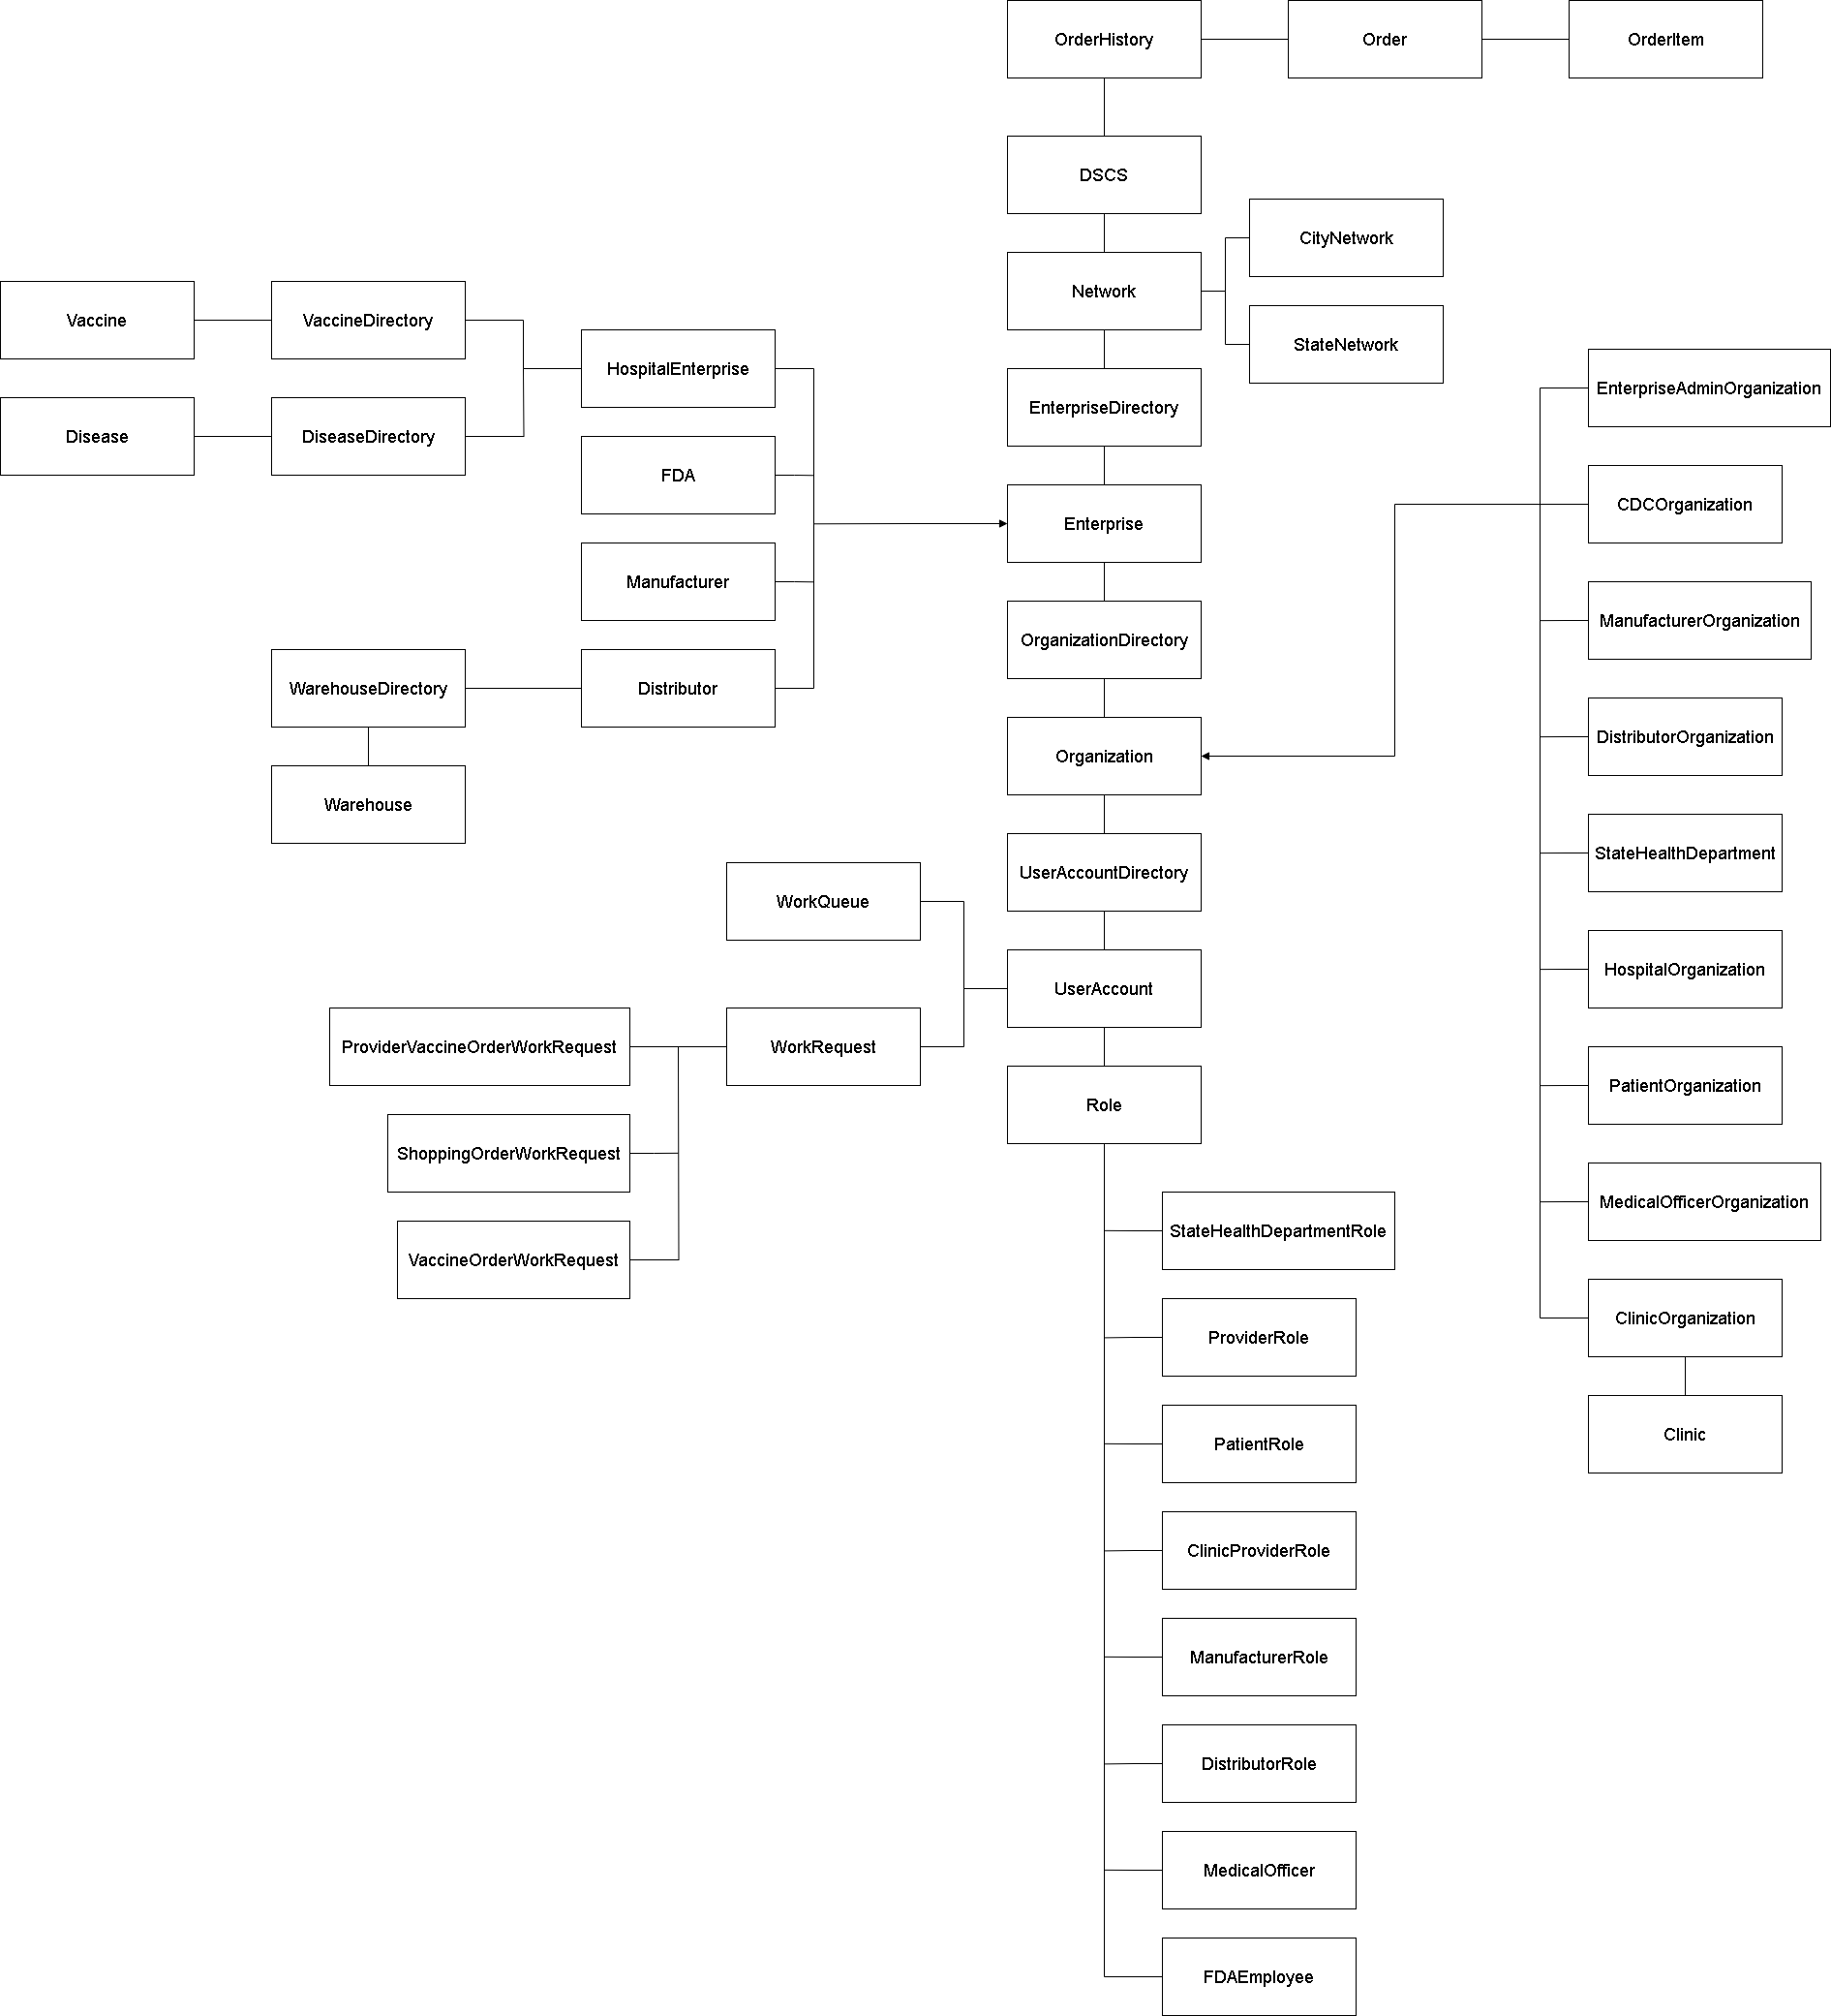
Architecture Diagram

Slide 10
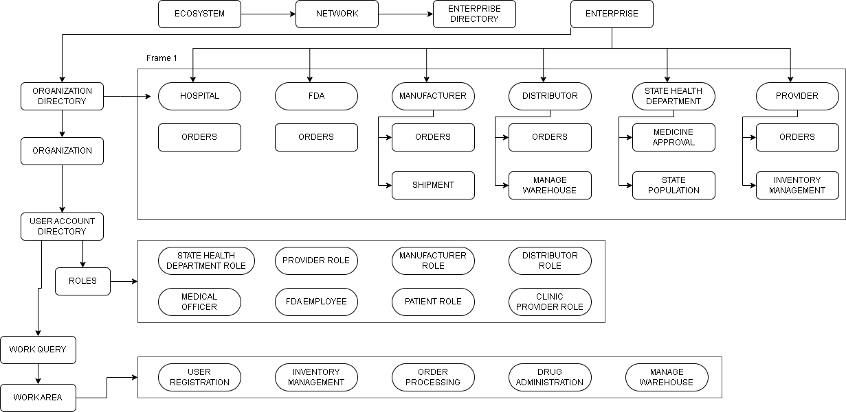
Component Diagram

Slide 11
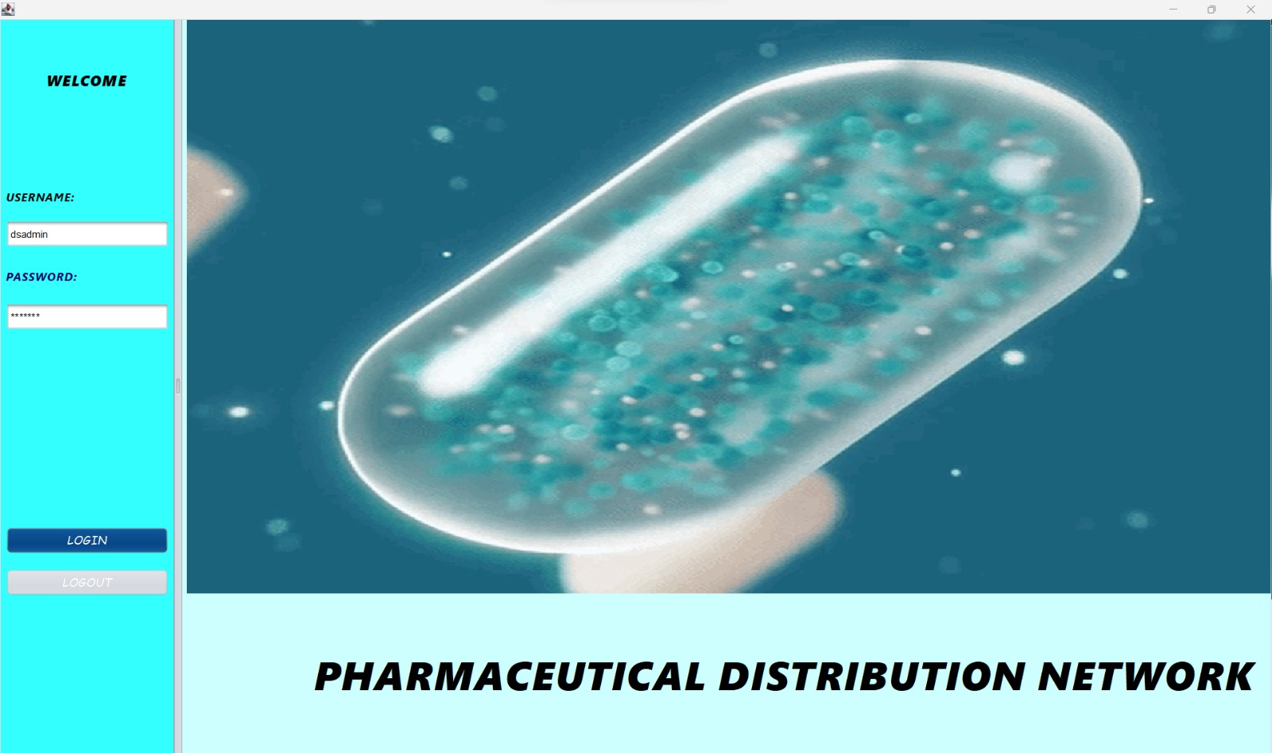
System Admin Login

Slide 12
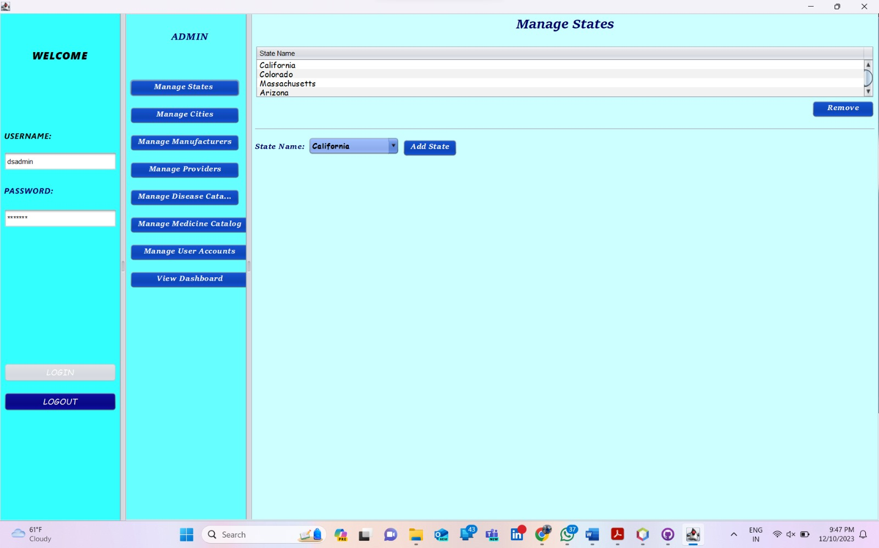
Manage States

Slide 13
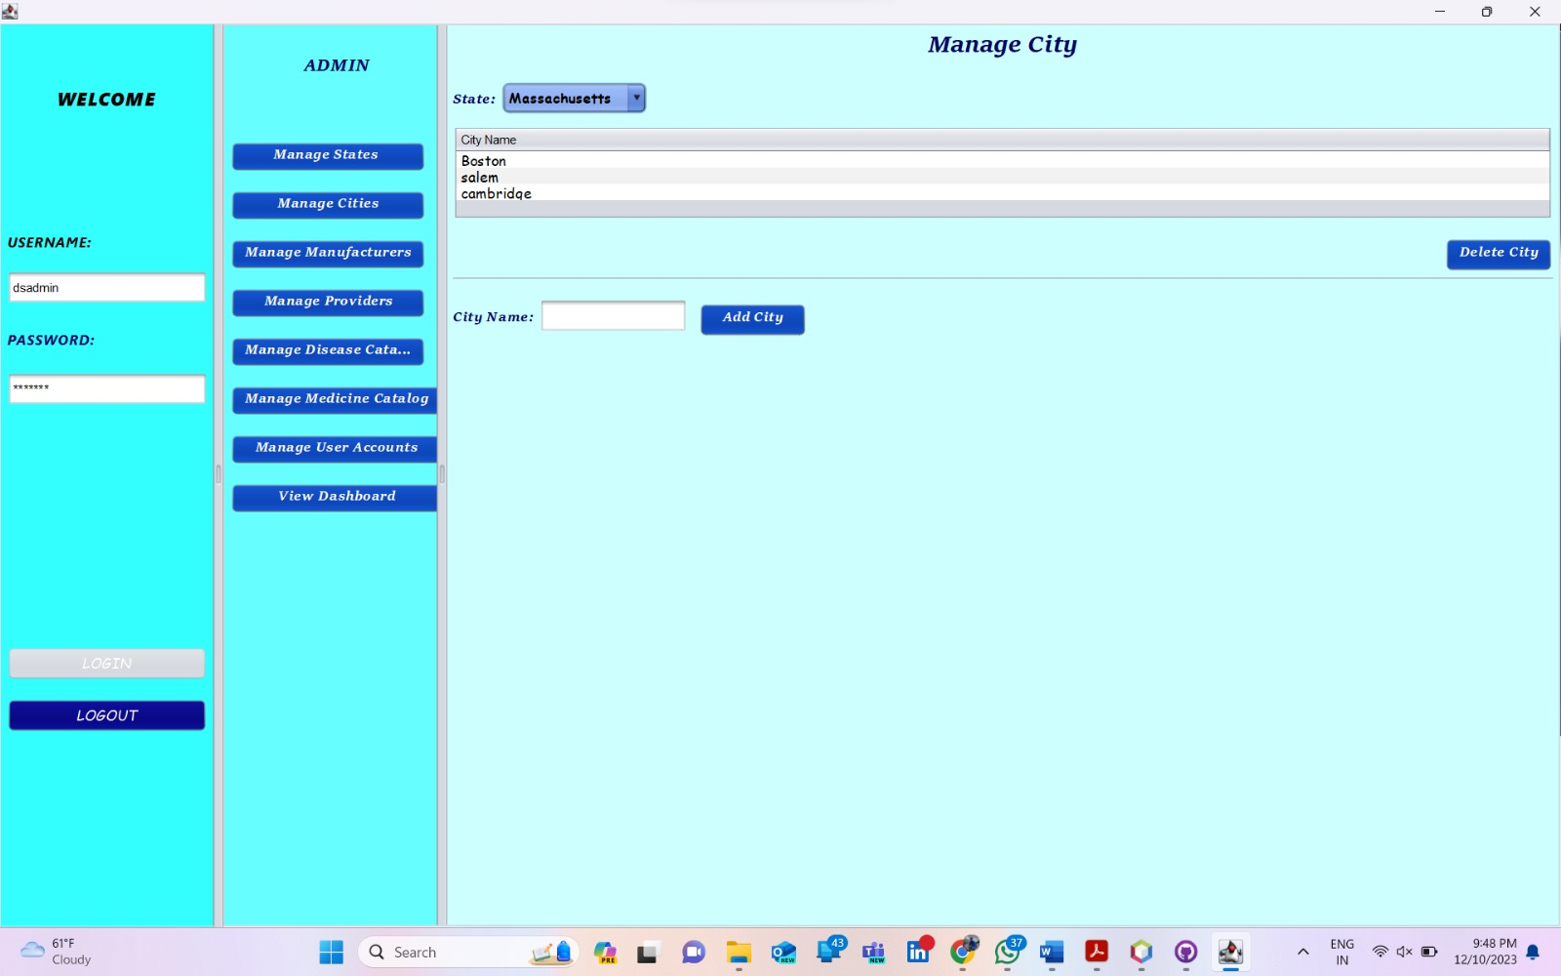
Manage Cities

Slide 14
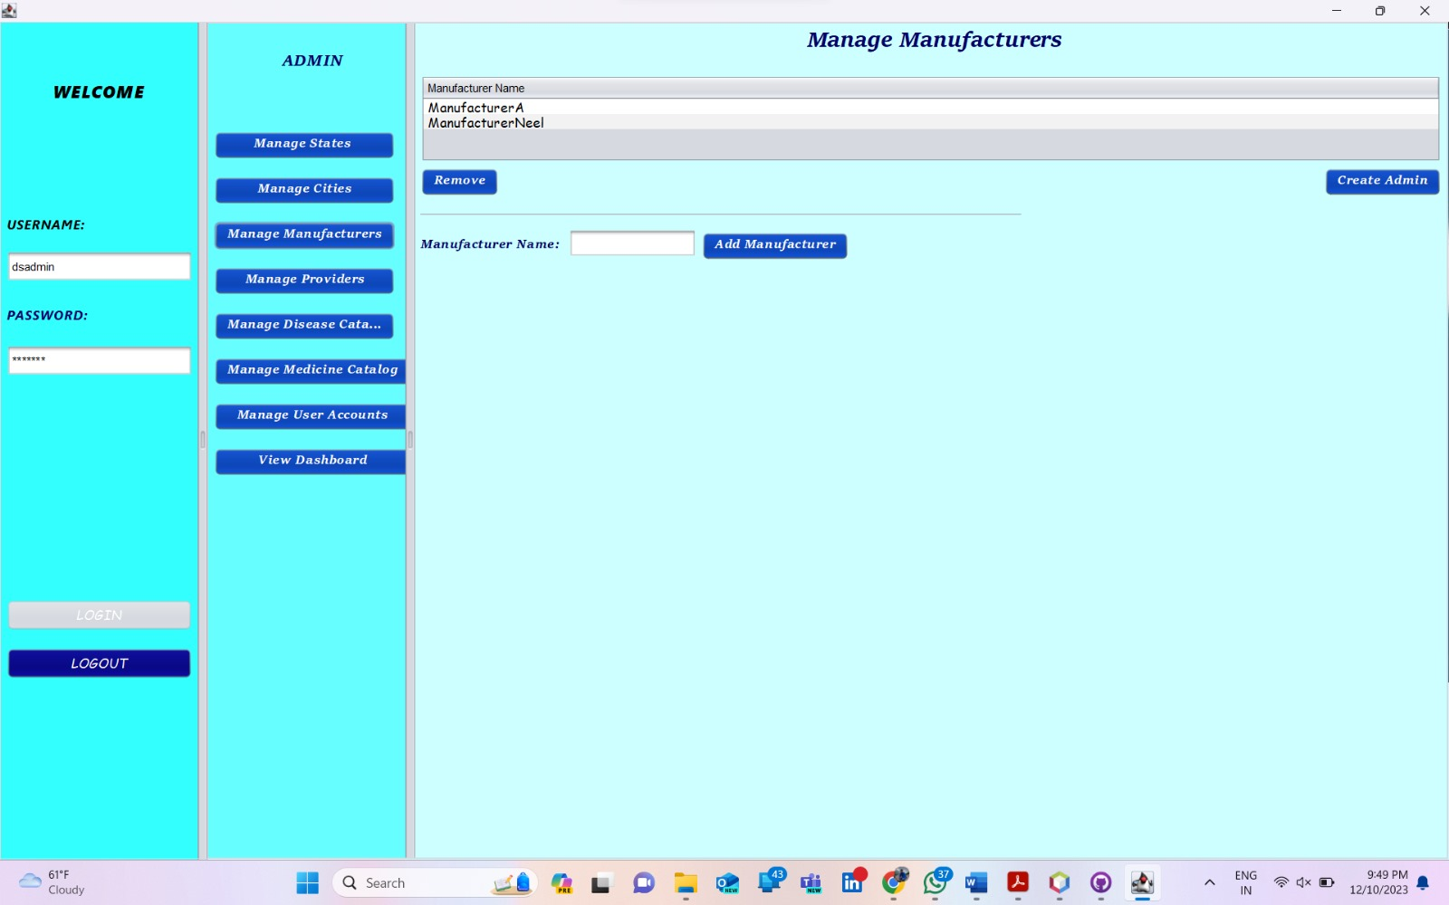
Create Manufacturer Name As Admin

Slide 15
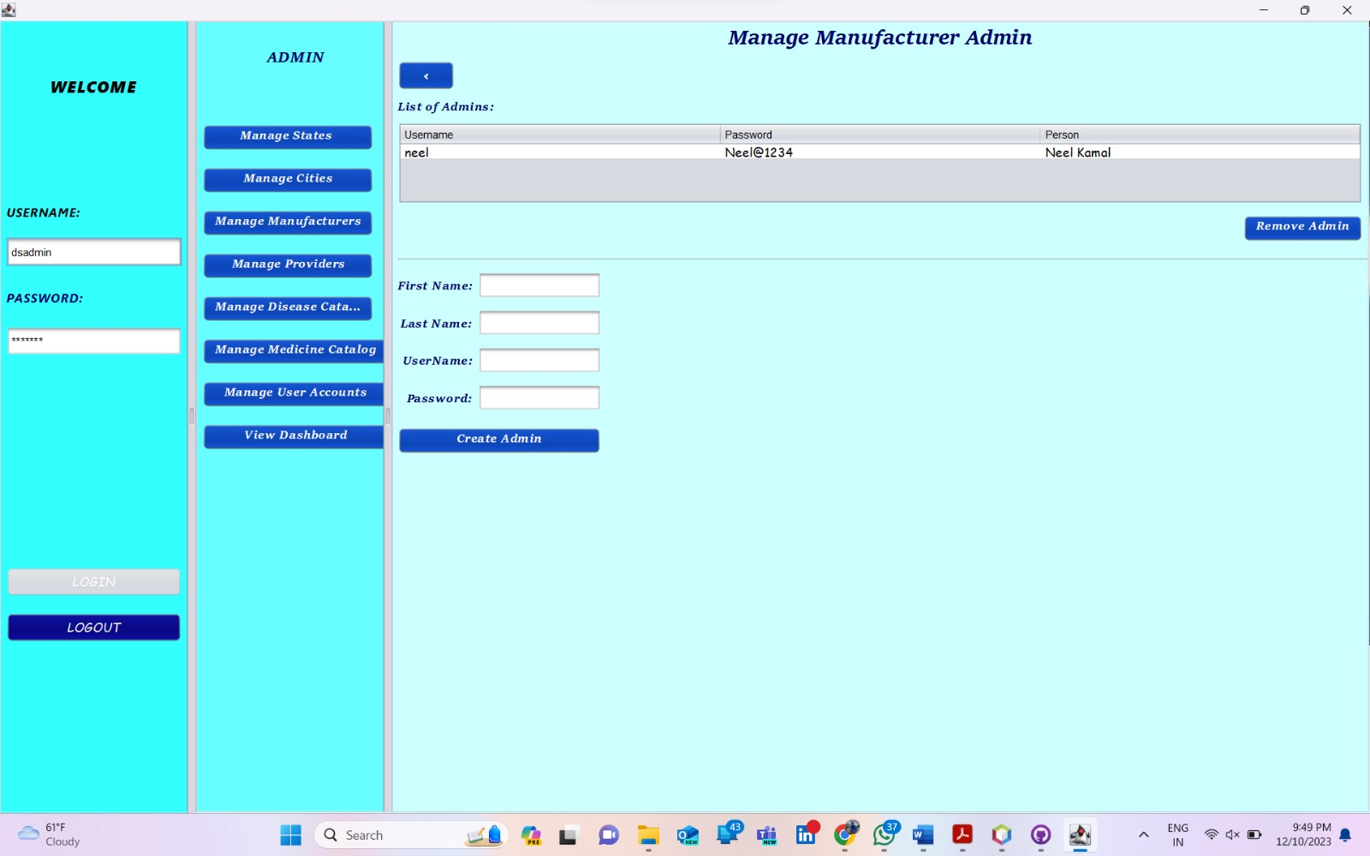
Creating User Creds For Manufacturer Admin

Slide 16
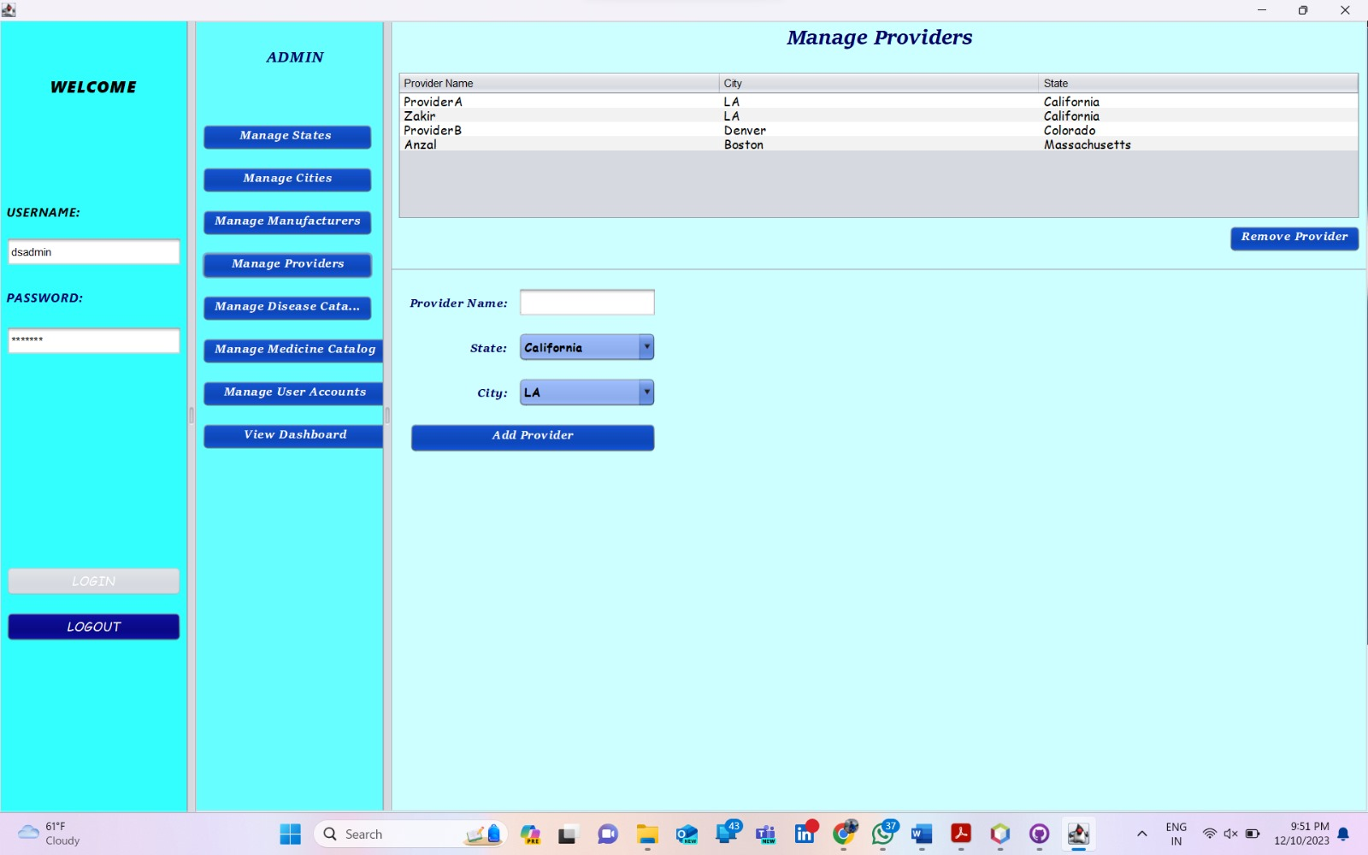
Manage Providers By Creating And Removing Them

Slide 17
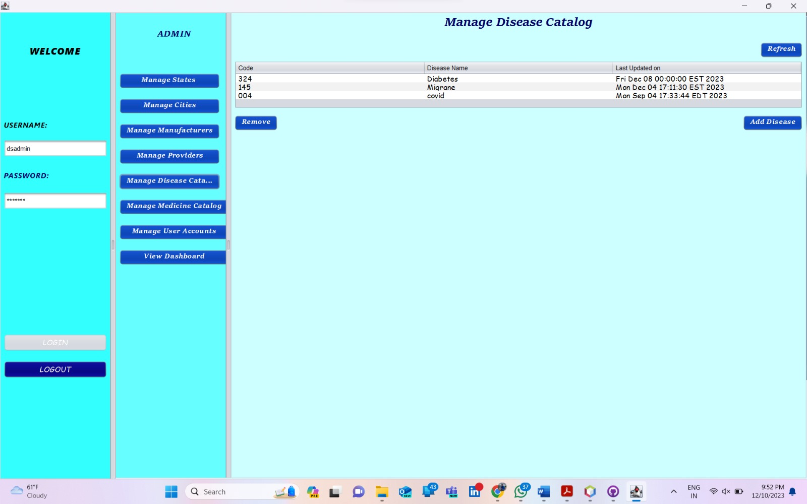
Creating Disease Catalog By Sys Admin

Slide 18
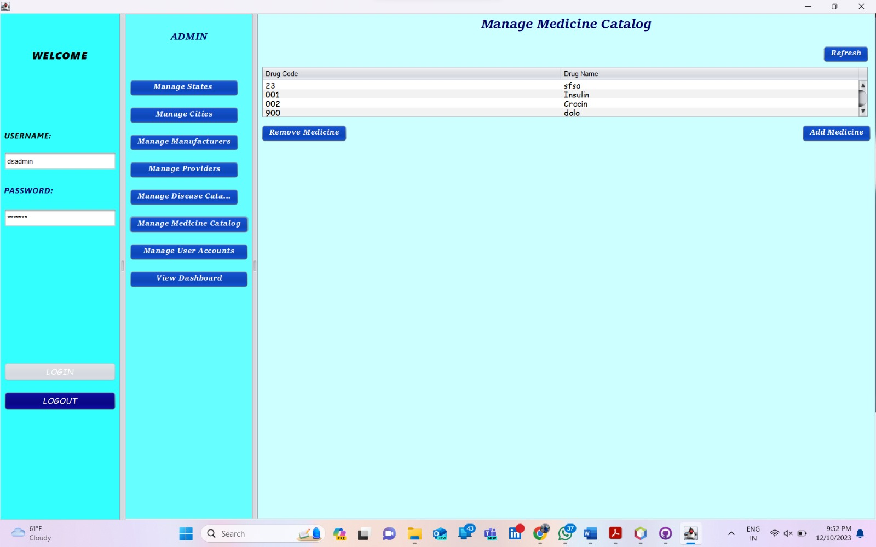
Creating And Removing Medicines

Slide 19
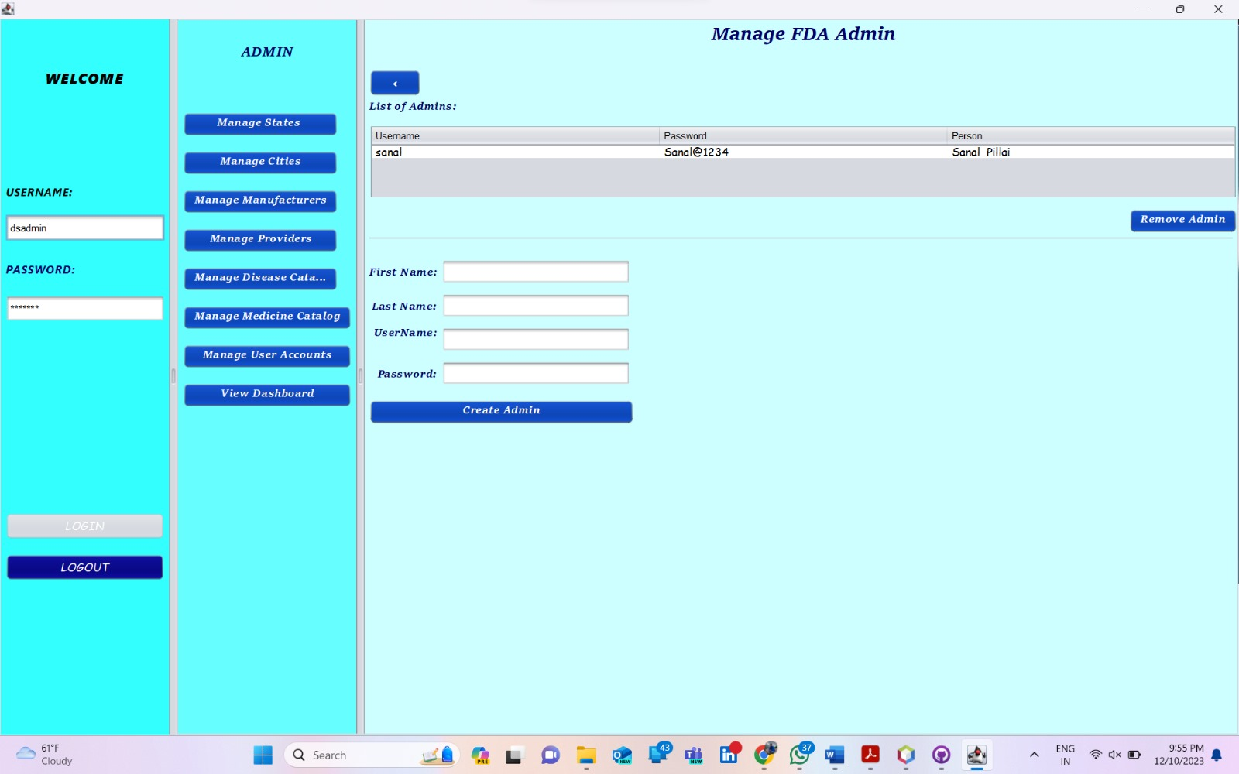
Creating FDA Admin

Slide 20
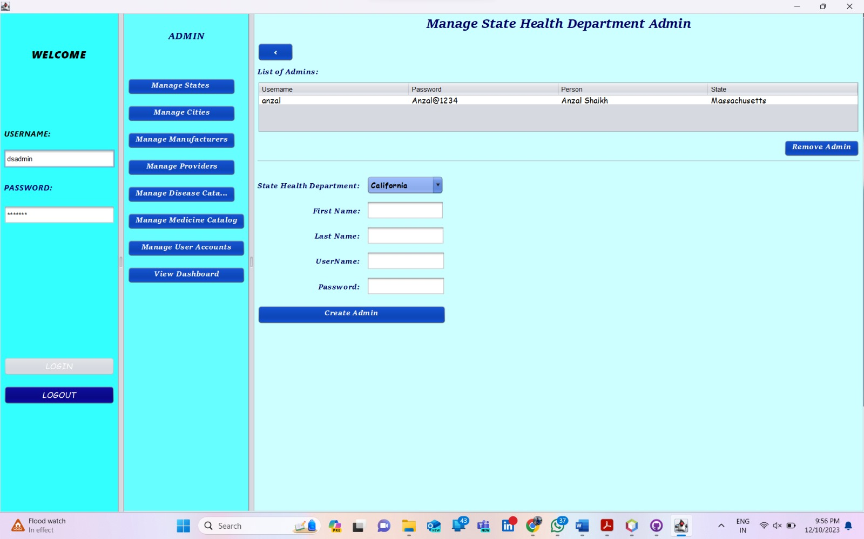
Creating State Health Admin User

Slide 21
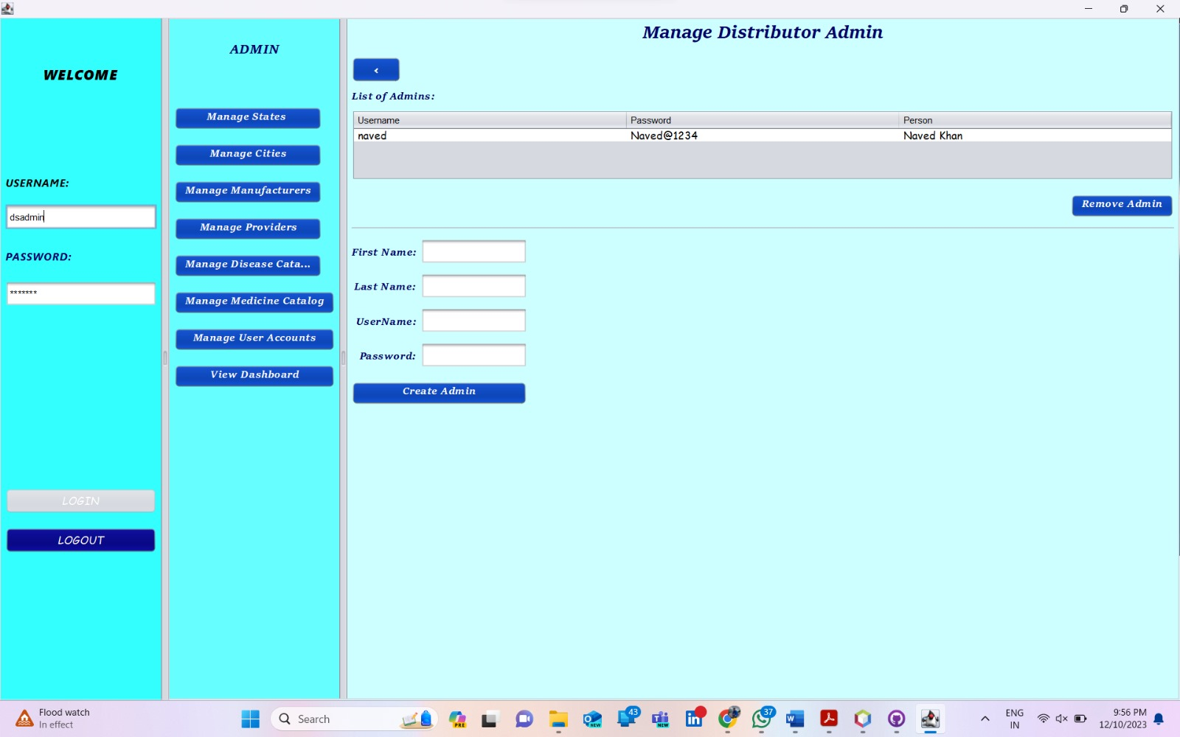
Creating And Managing Distributor Admin

Slide 22

Creating And Managing Provider Admins

Slide 23
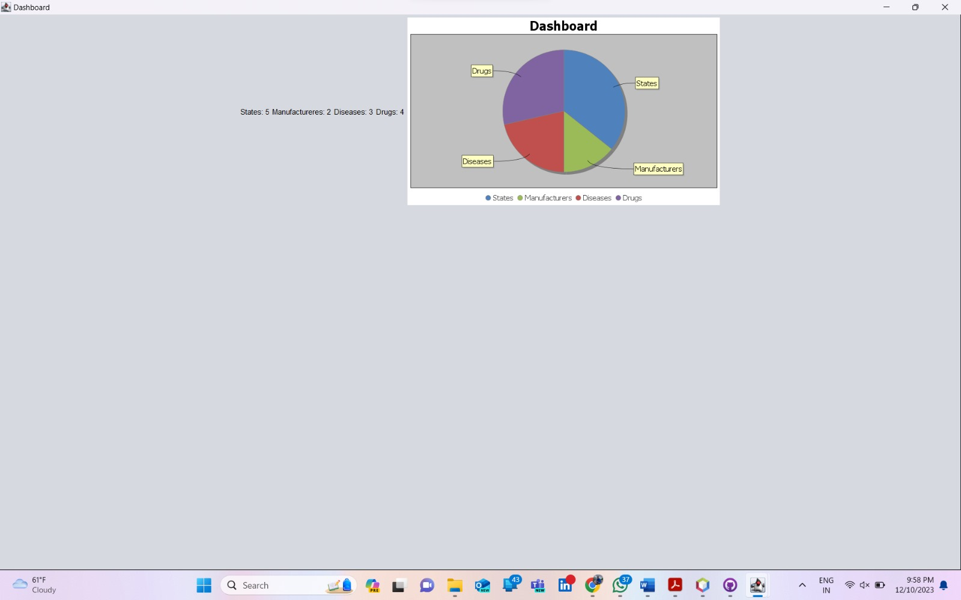
Performance Based On States , Manufacturers , Diseases And Drugs Under System Admin

Slide 24
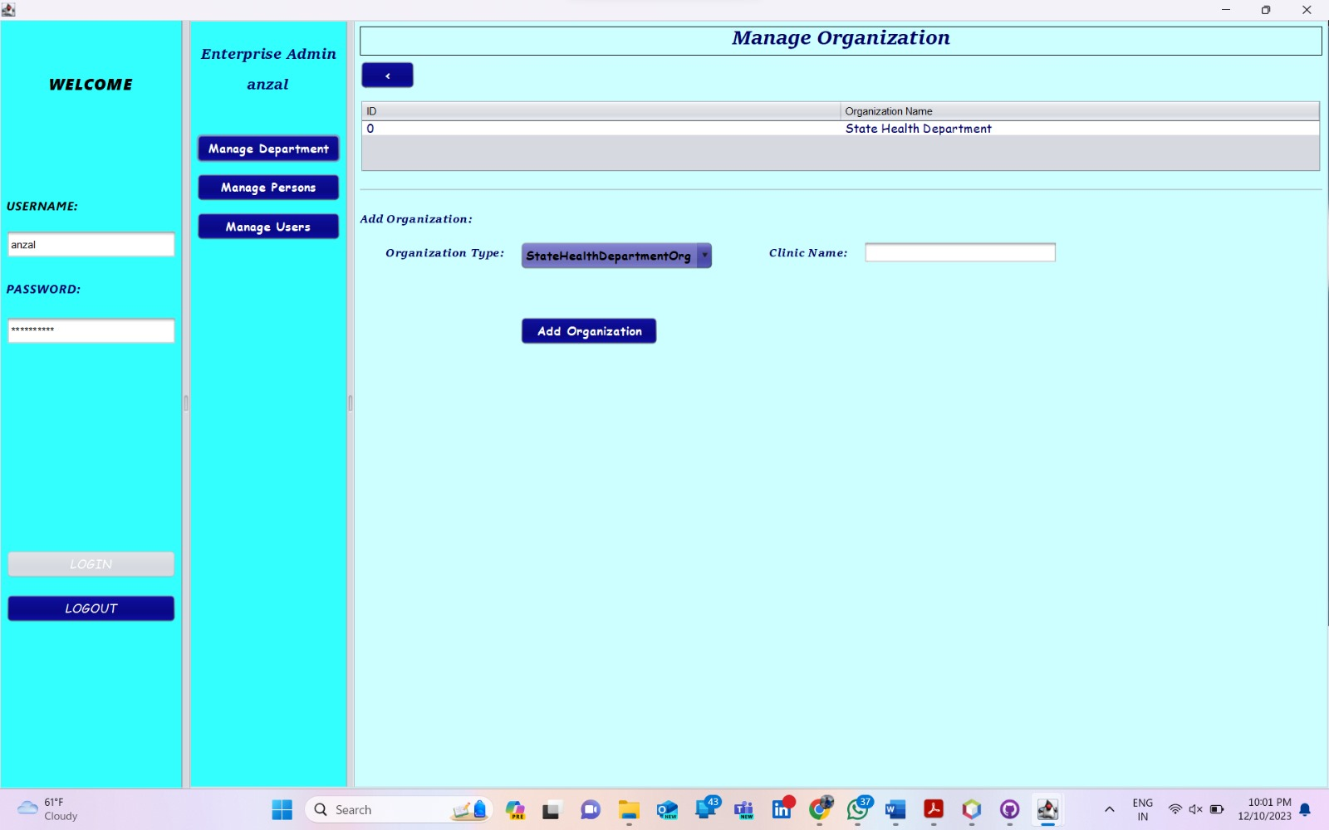
Managing Departments For State Health Admin Organization

Slide 25
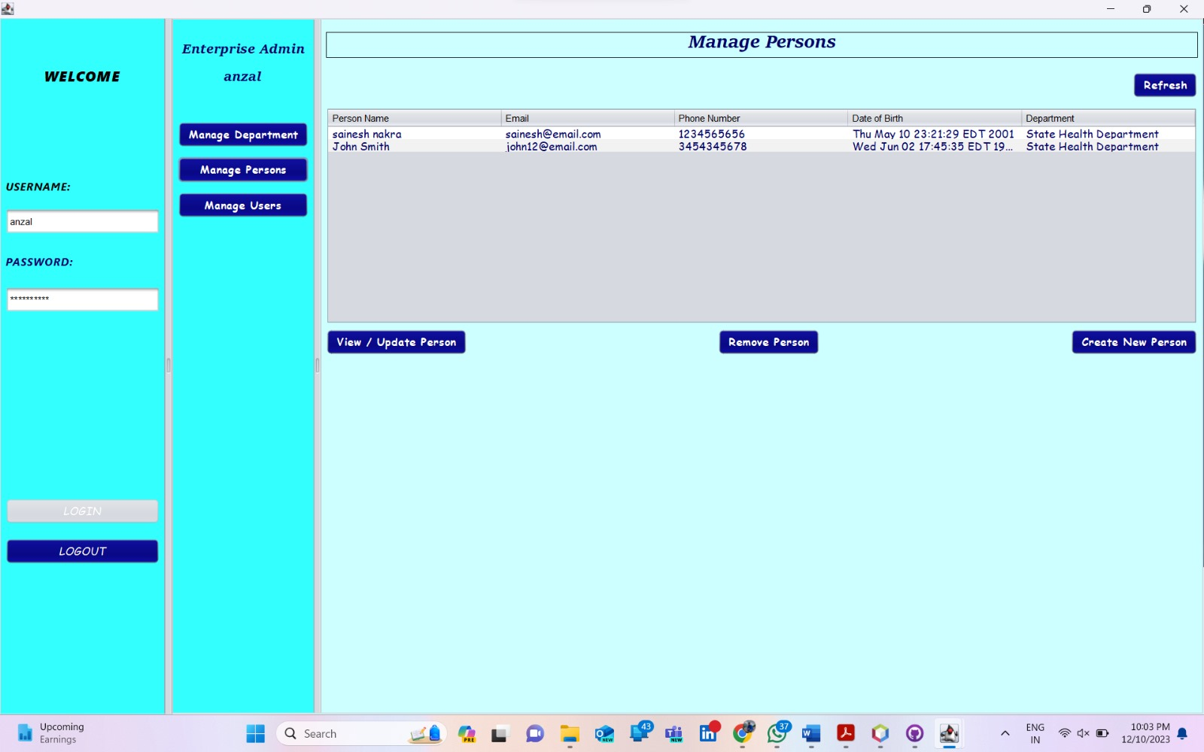
Creating And Update Employees For State Health Admin Org

Slide 26
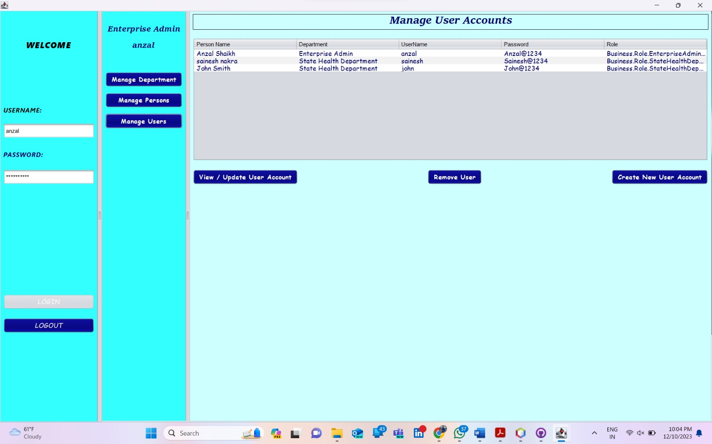
Creating User Details For Employees Of State Health Admin Org

Slide 27
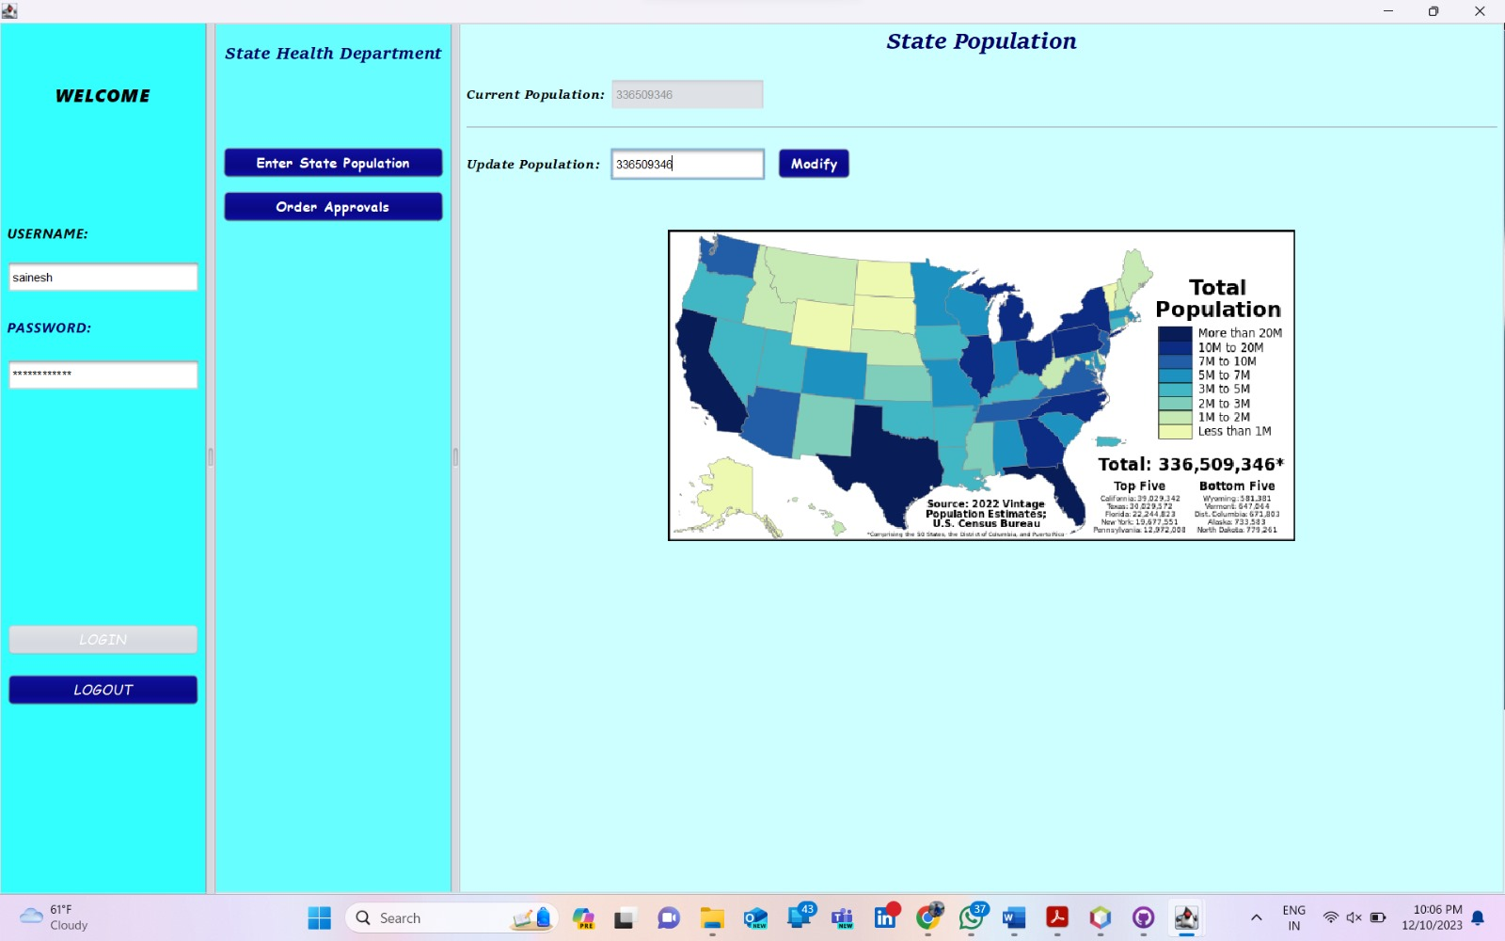
Adding State Population By State Health Administration Employee

Slide 28

Managing And Creating Department (FDA Organization And Medical Organization) By FDA Employee

Slide 29
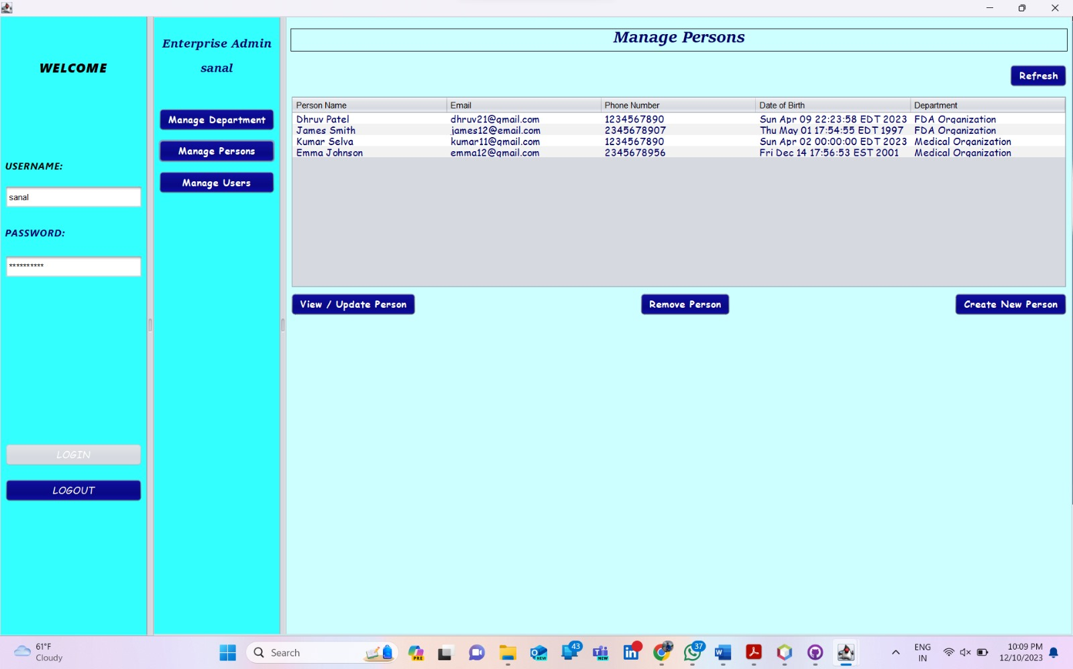
Creating And Updating Persons For FDA Org And Medical Org By FDA Admin

Slide 30
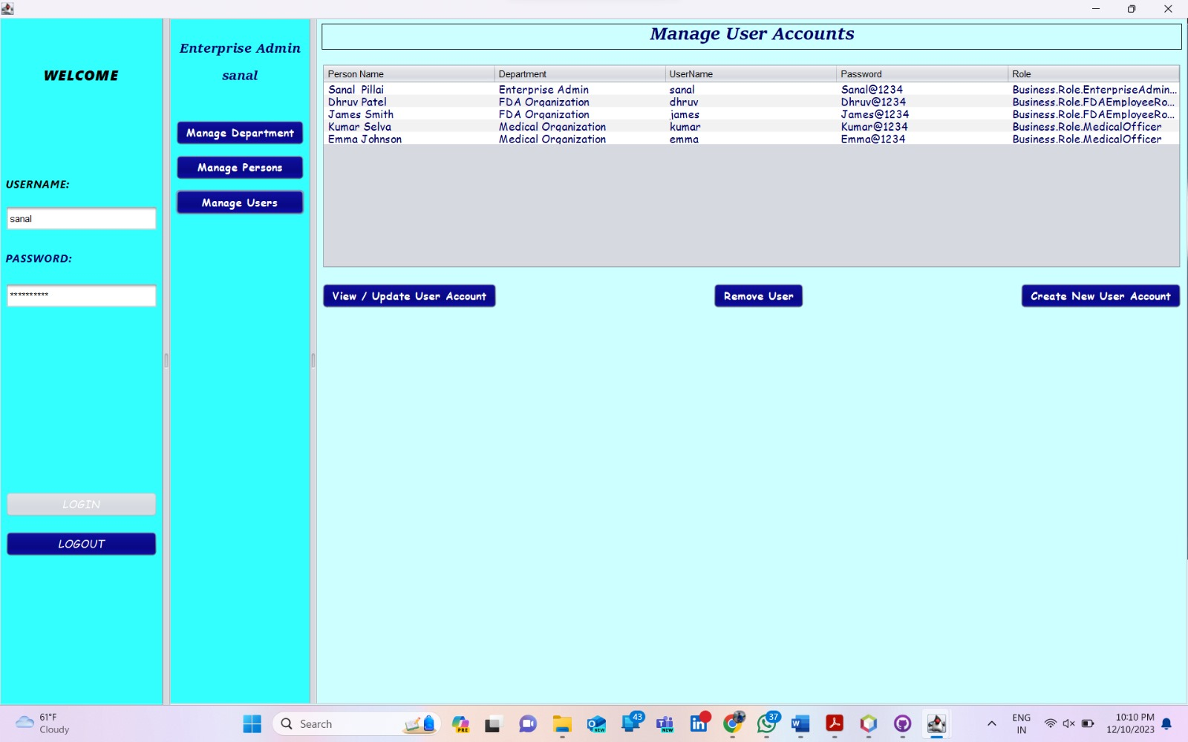
Creating And Updating Employee Creds For FDA Org And Medical Org By FDA Admin

Slide 31
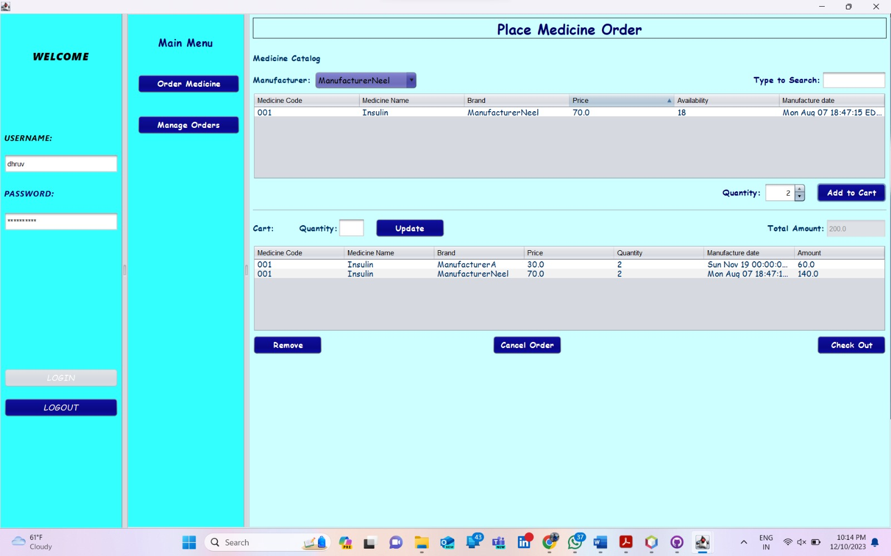
Ordering Medicine Based On Different Manufacturer By FDA Employee

Slide 32
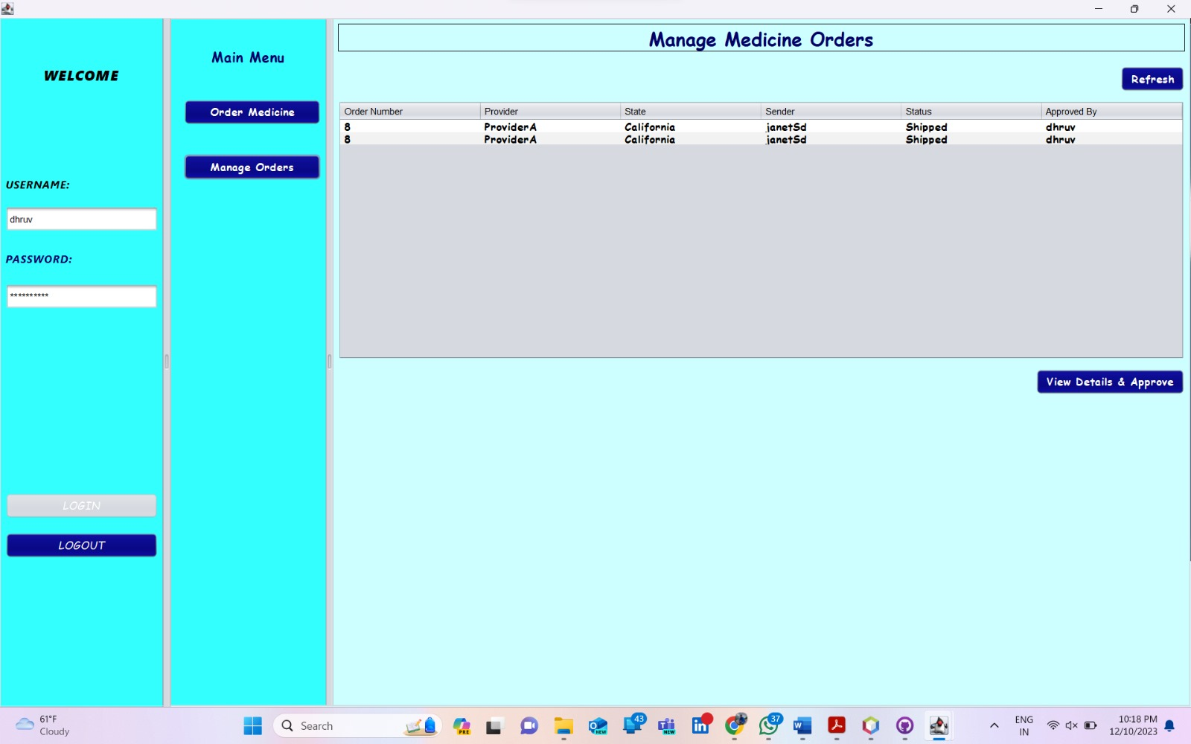
Managing Medicine Orders By FDA Employee

Slide 33
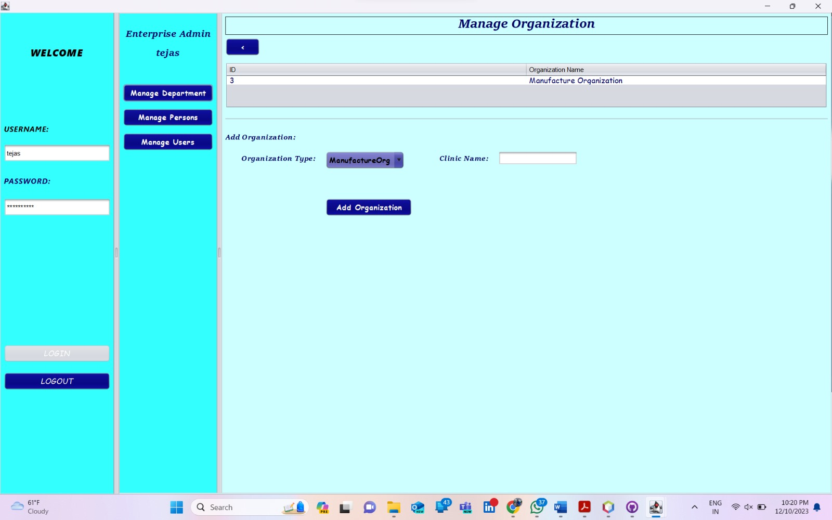
Creating And Managing Manufacturer Organization

Slide 34
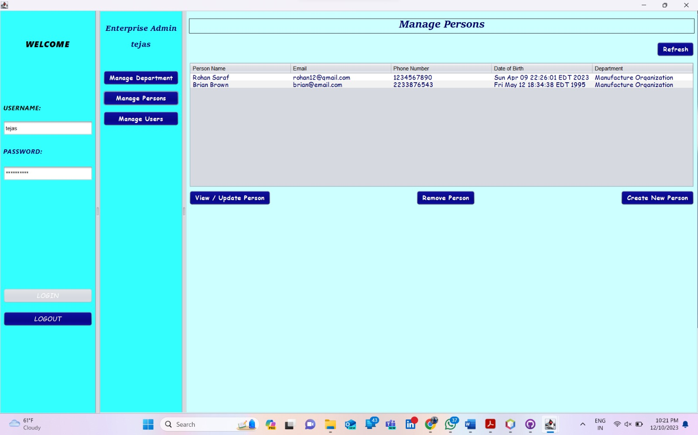
Creating And Updating Manufacturer Org Persons By Manufacturer Admin

Slide 35

Creating And Updating Manufacturer Employee Creds By Manufacturer Admin

Slide 36
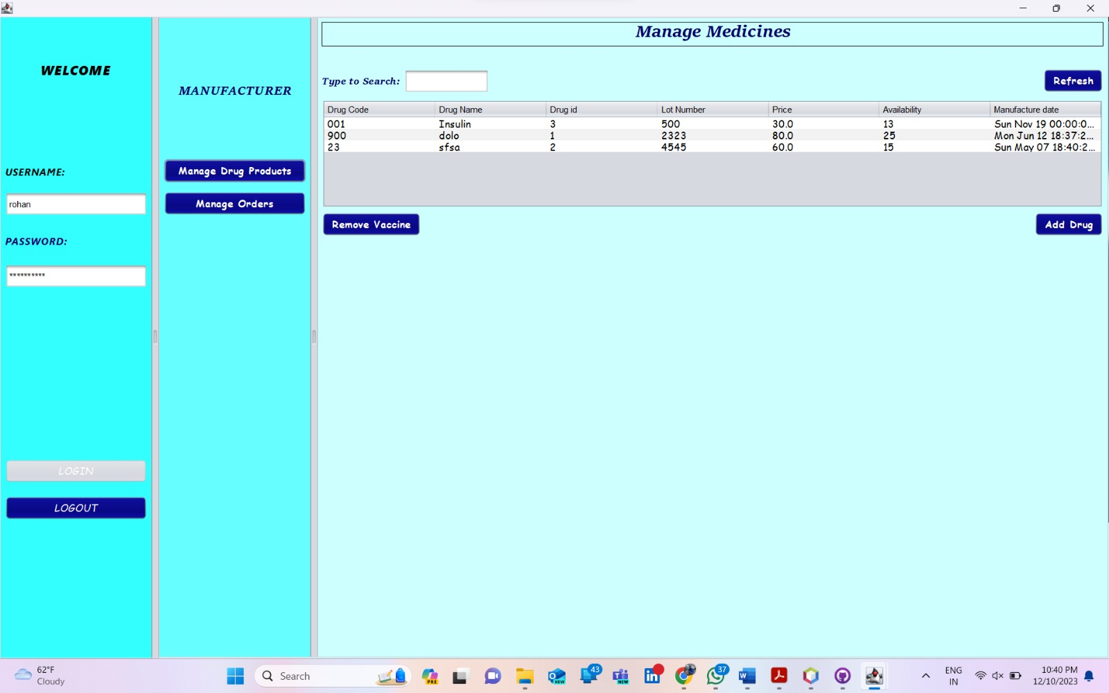
Create And Remove Medicine Products By Manufacturer Employee

Slide 37
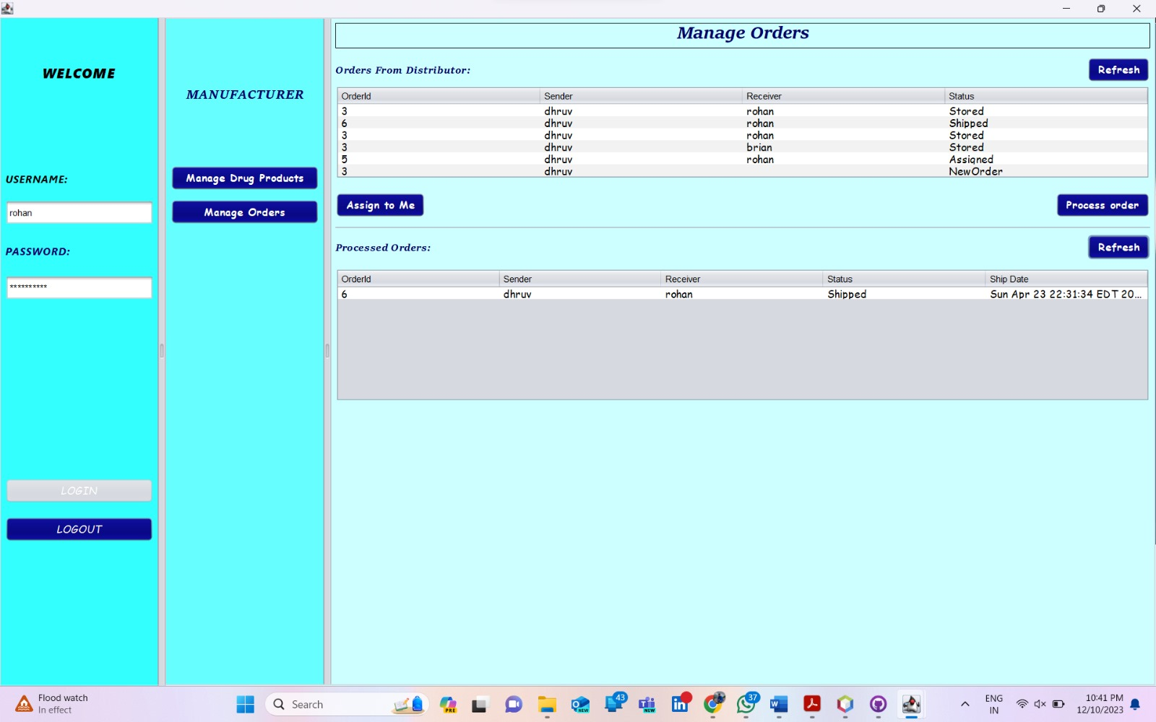
Assign Order To Individual Manufacturer Employee And Process It

Slide 38

Creating And Managing Department By Distributor Admin

Slide 39

Creating And Updating Persons Of Distributor Organization By Distributor Admin

Slide 40

Creating And Updating Distributor Employee Users By Distributor Admin

Slide 41
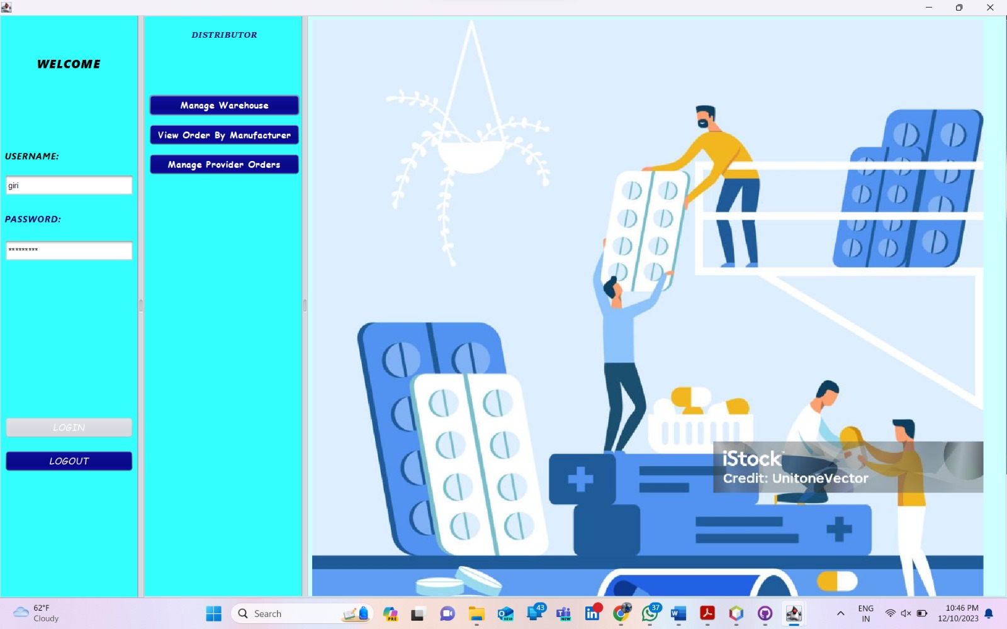
Distributor Employee Homepage

Slide 42
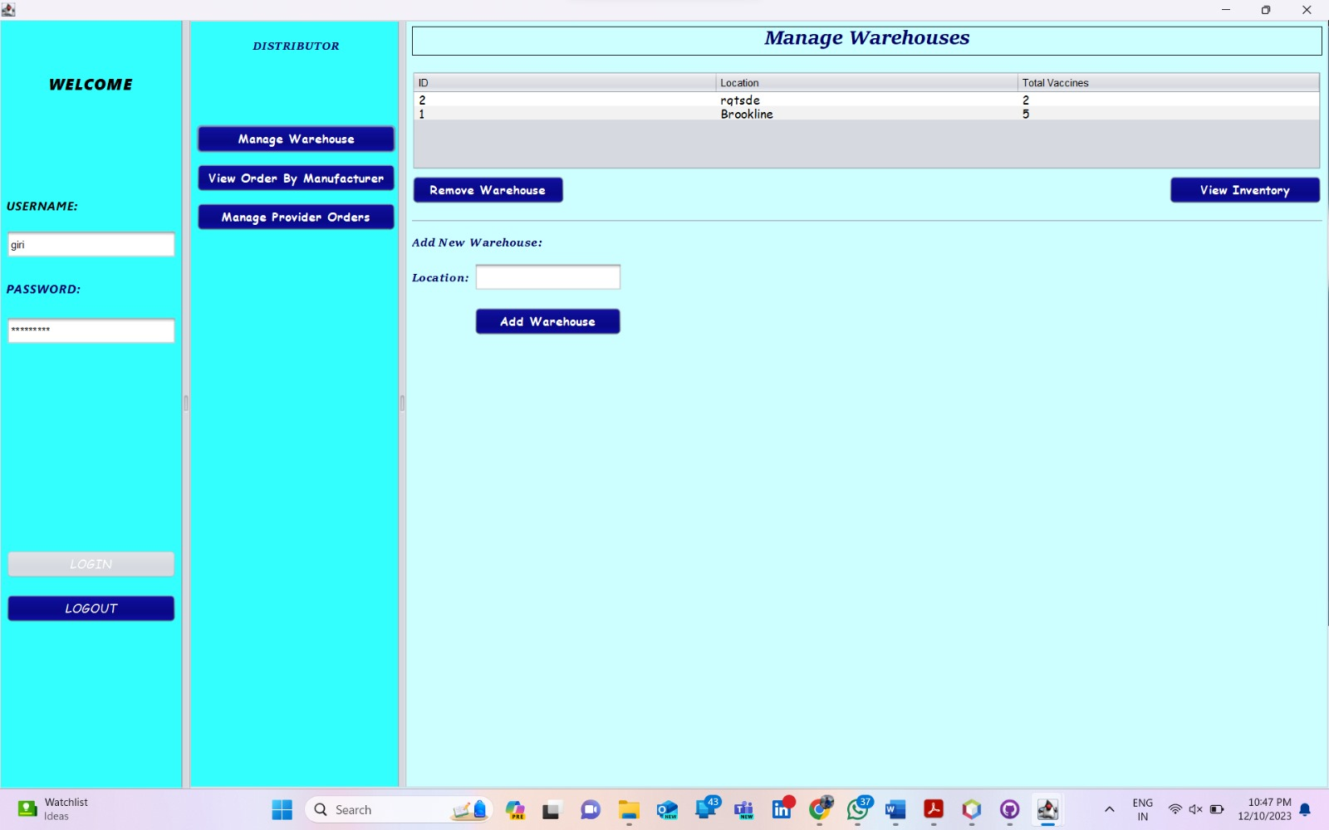
Managing And Creating Warehouse By Distributor Employee

Slide 43
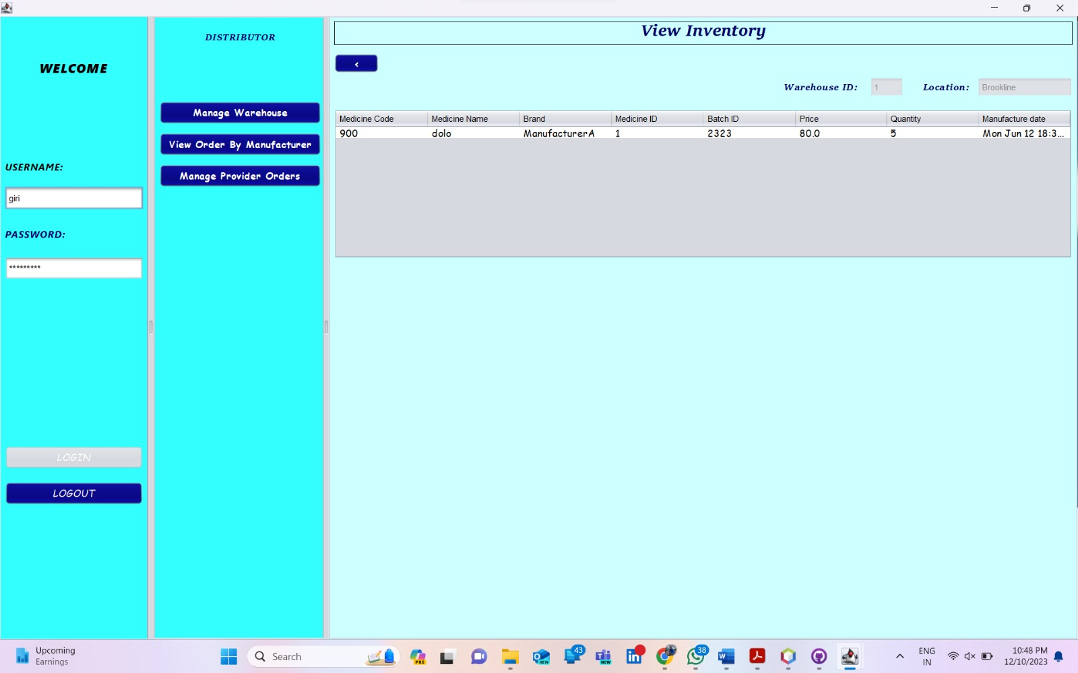
View Inventory Based On Warehouse Location By Distributor Employee

Slide 44
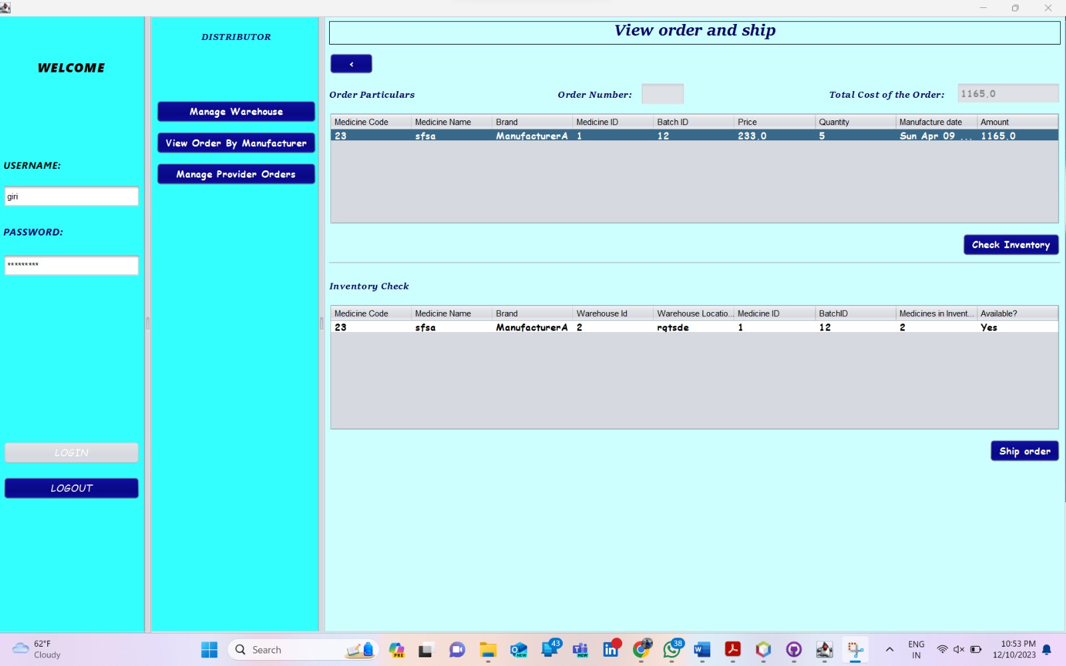
Ship Order By Distributor Employee

Slide 45
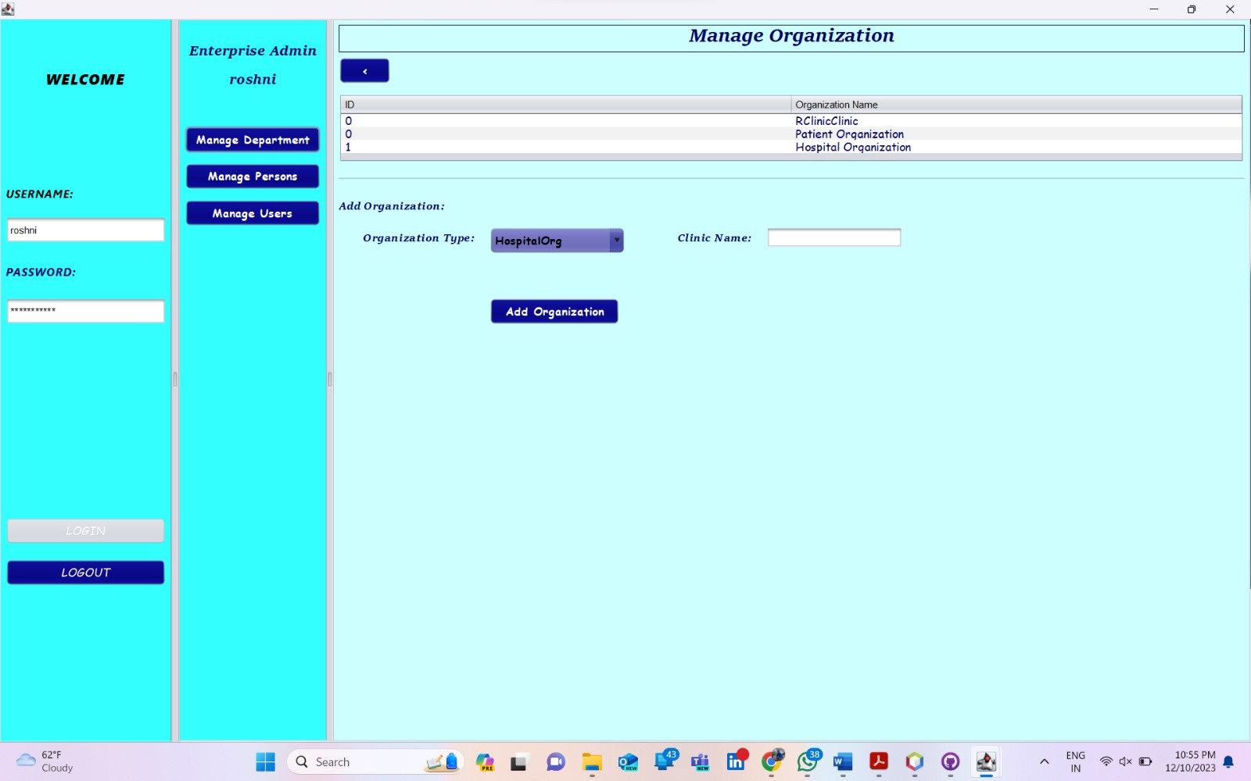
Managing Doctor, Patient And Clinic Organization By Provider Admin

Slide 46

Creating And Updating Persons For Clinic , Patient And Hospital Org By Provider Admin

Slide 47
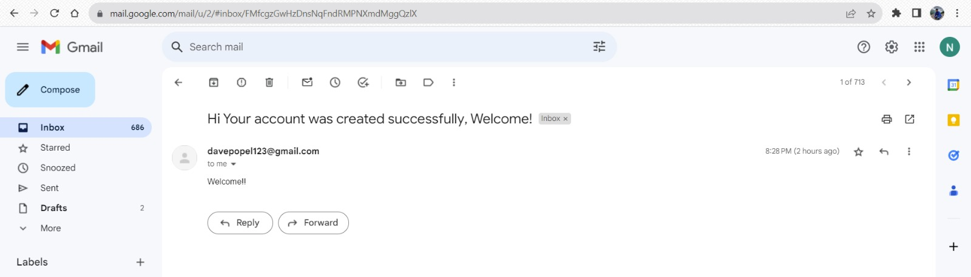
Email Sent When New Patient Is Created By Provider Admin

Slide 48

Creating And Updating Clinic, Patient And Hospital Org Employee Creds By Provider Admin

Slide 49
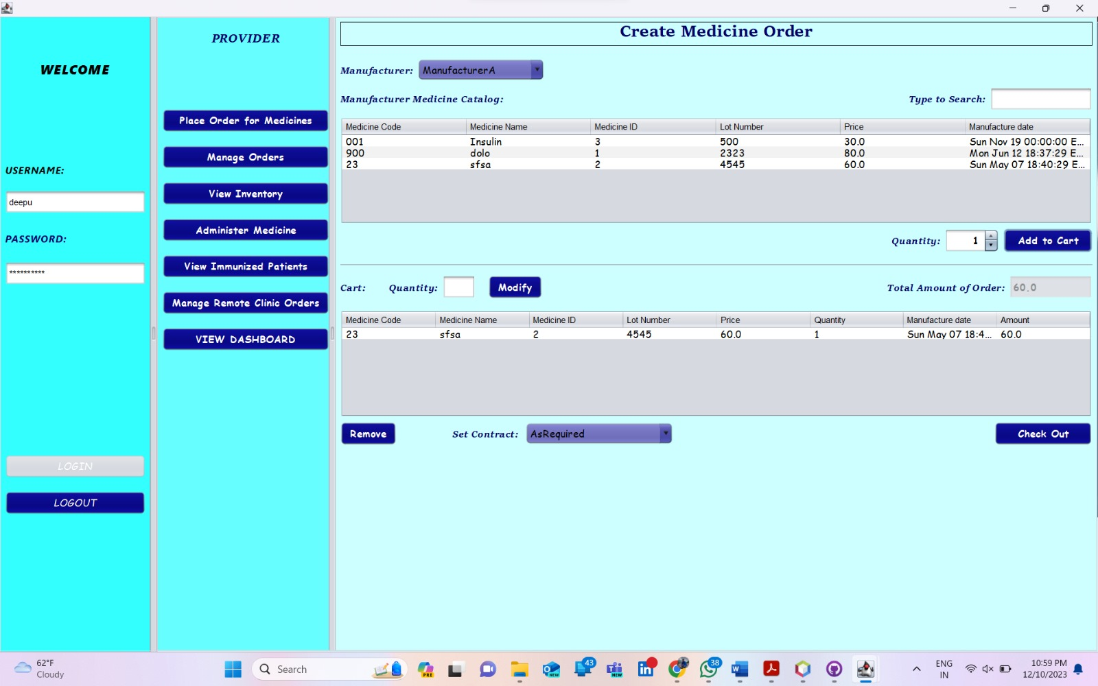
Ordering Medicine Based On Different Manufacturer By Doctor (Hospital Org)

Slide 50
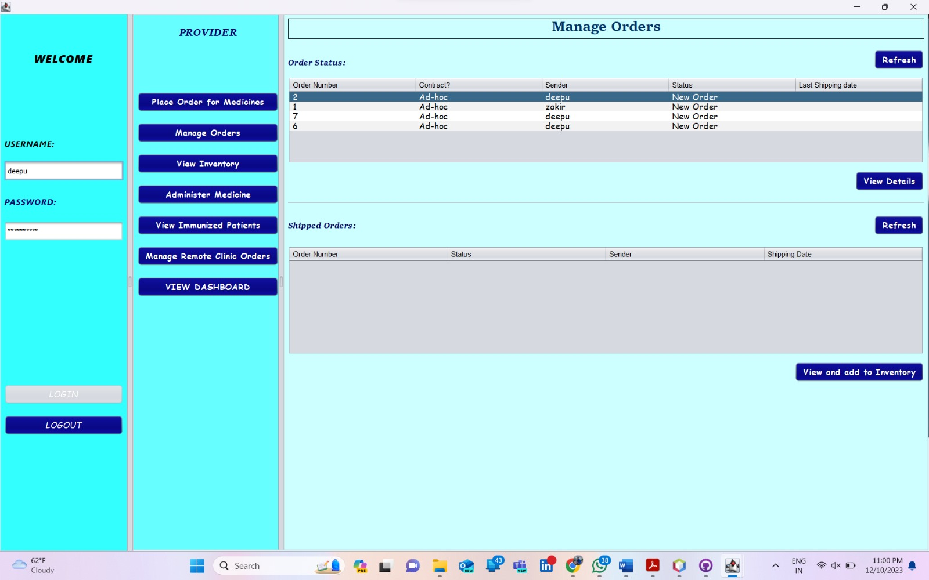
Managing Order On Doctor’s End

Slide 51
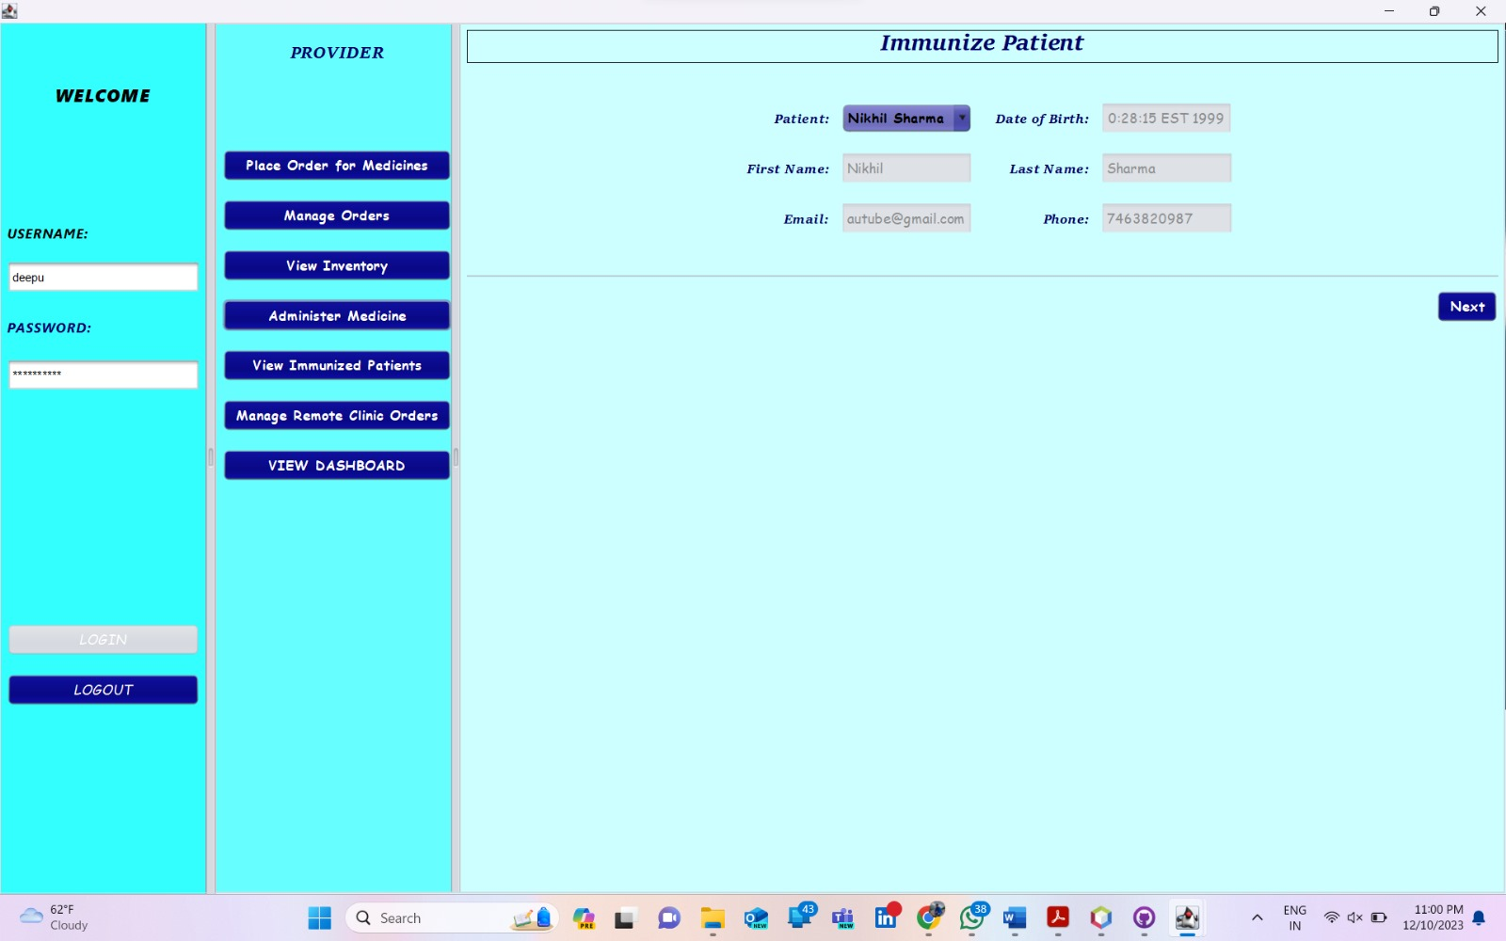
Managing Immunization Of Patient From Doctor UI

Slide 52
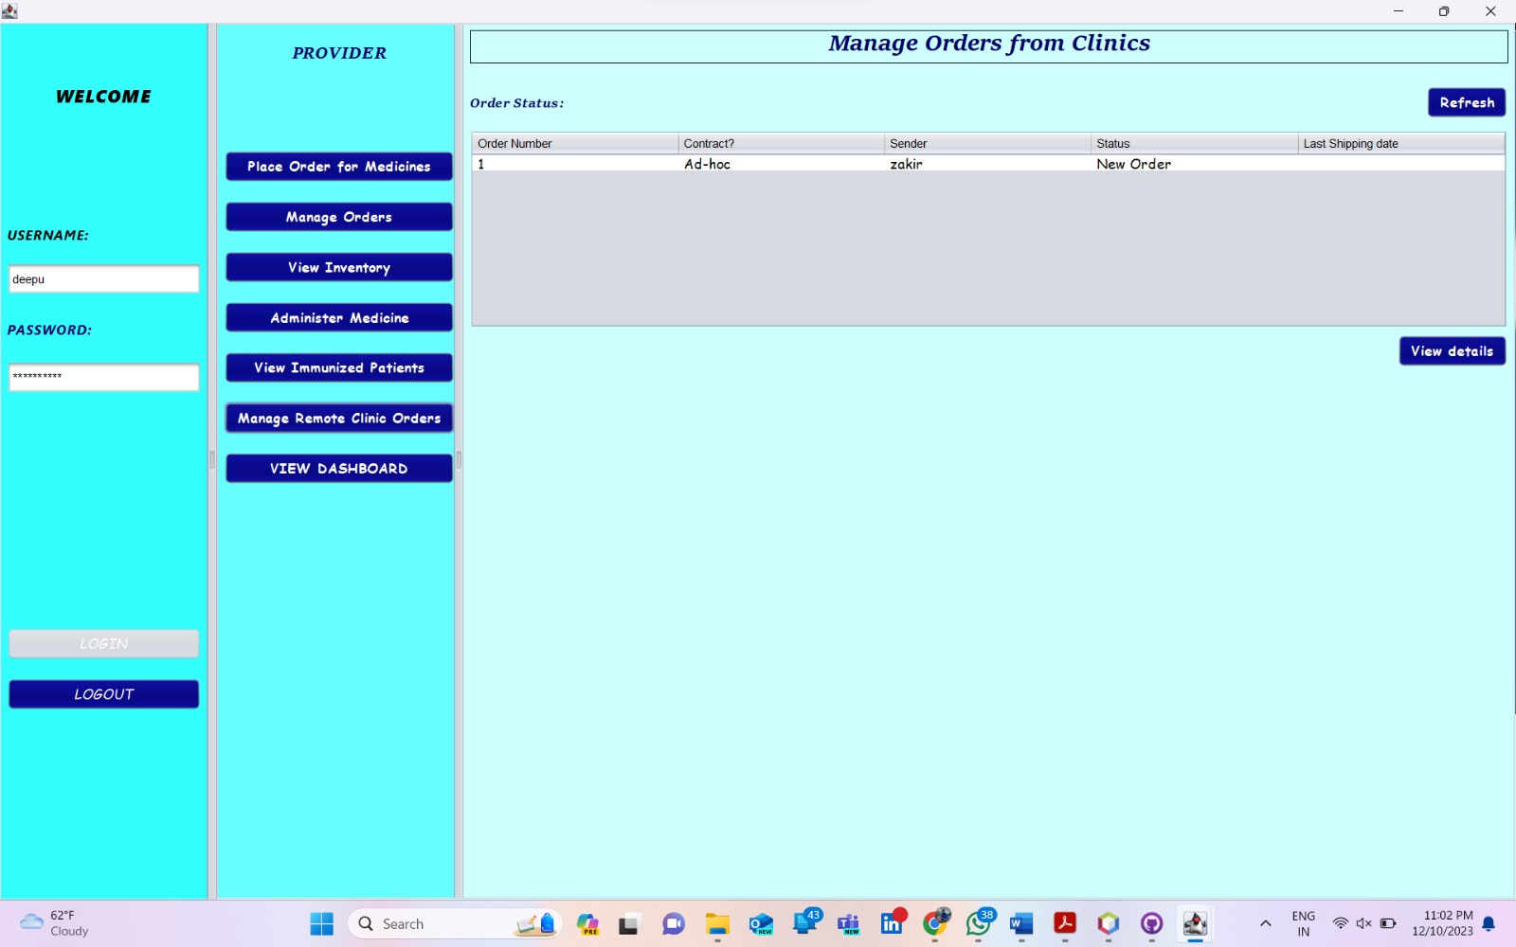
Managing Order Placed By Clinic Org

Slide 53
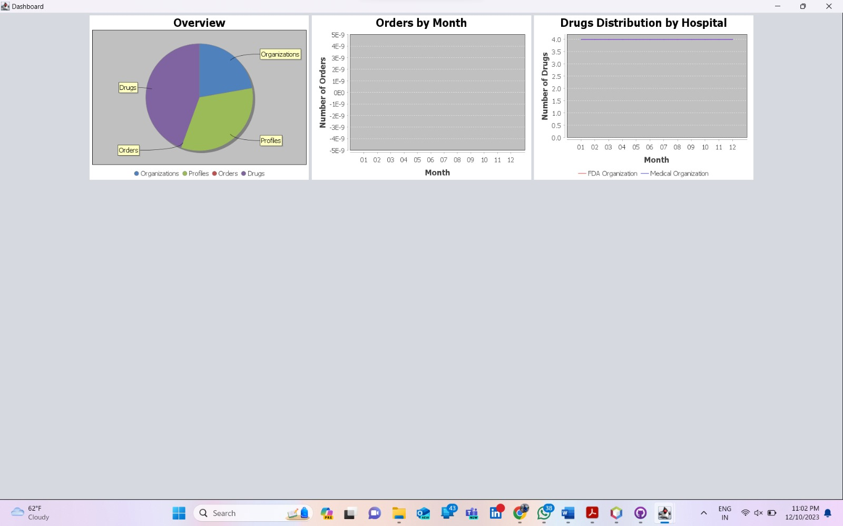
Dashboard Of Orders Being Placed By Provider Employees And Consumers

Slide 54
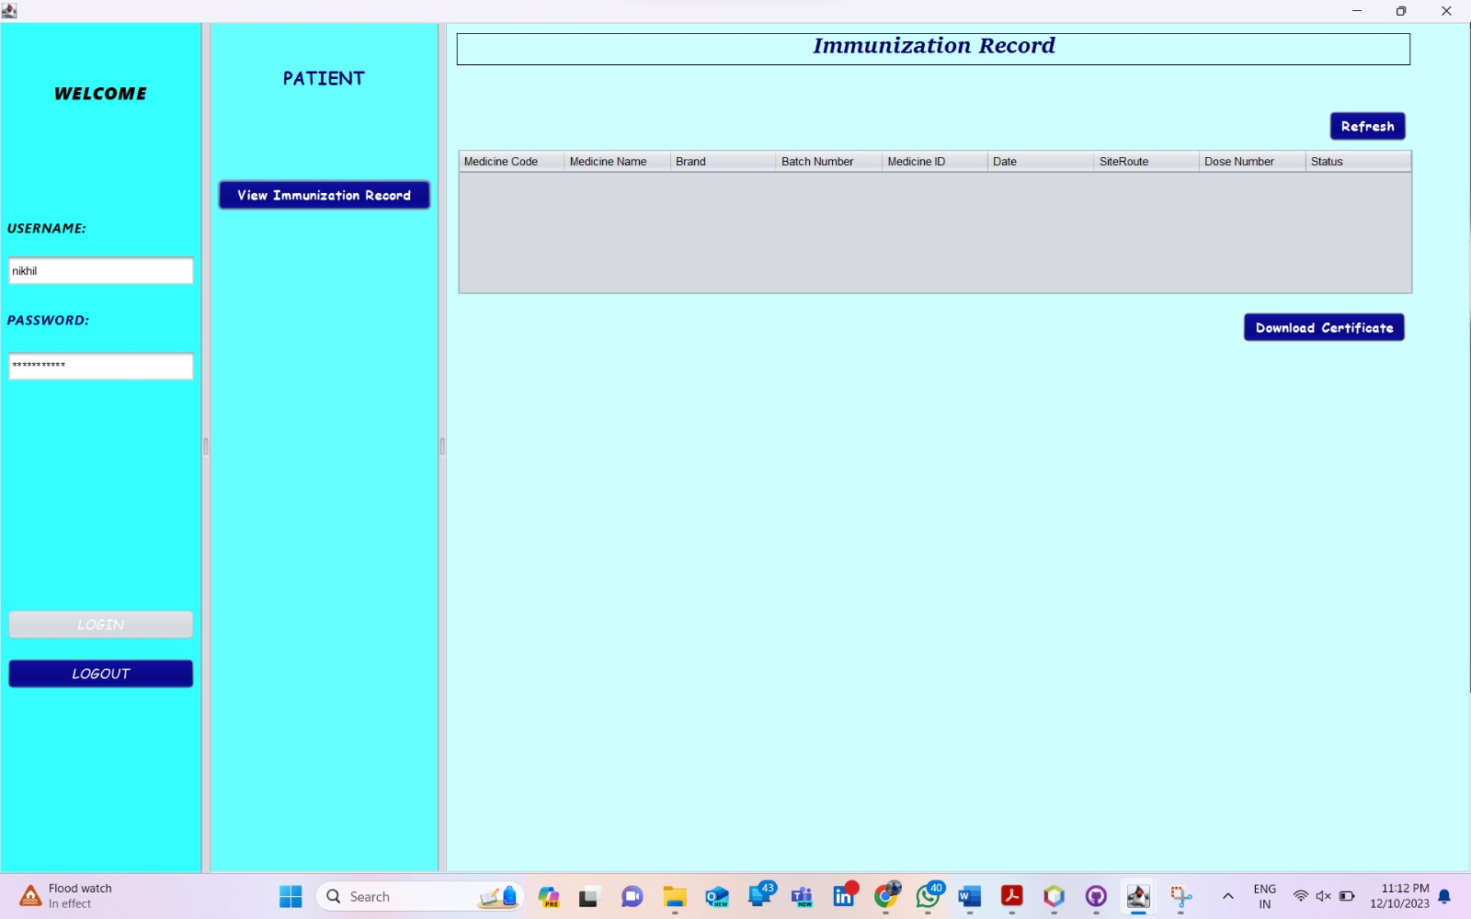
Patient View To Download And View Immunization Report

Slide 55
THANK YOU

